Slide 1
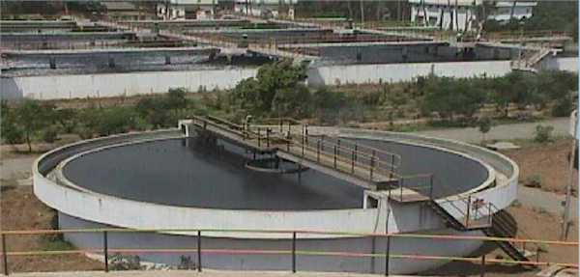
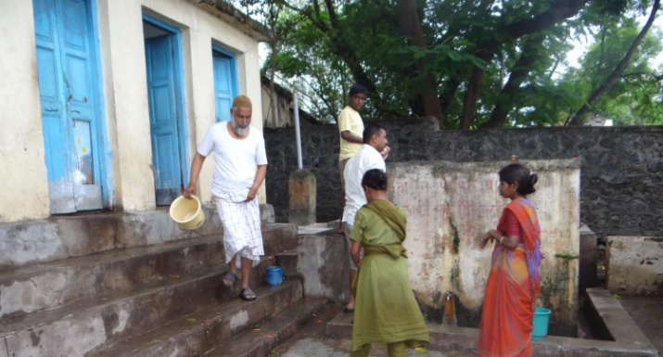
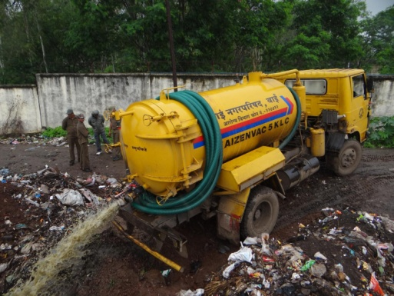
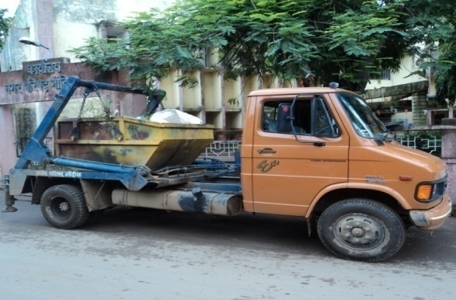
Service Level Benchmarking
Workshop on Sustainable and Disaster Resilient Urban Development
9th September, 2014
PAS Project

Slide 2
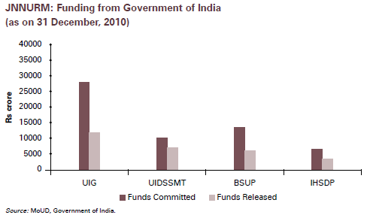
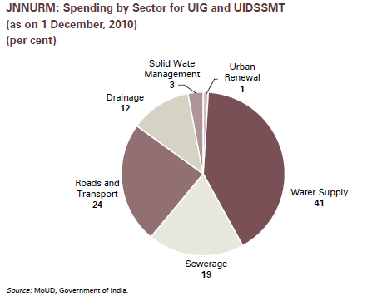
JNNURM: UWSS a priority
Largest urban infrastructure funding by GoI in 2005 through JnNURM with allocation of Rs. 66,000 crore
Water sector accounted for largest share at 41%, with UWSS getting >70% of the funding
Good monitoring of project implementation – but need for better data on outcome or service delivery improvements

Slide 3
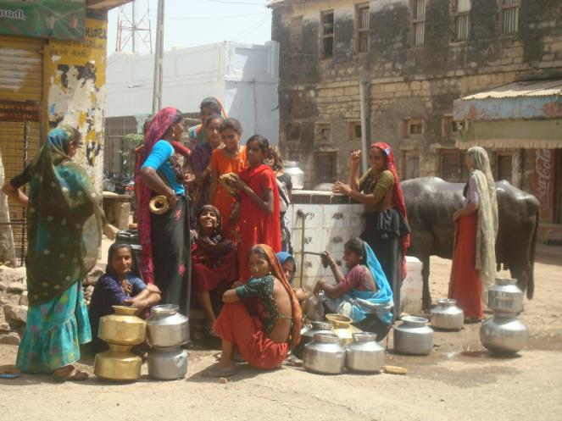
Need for performance information
Aggregate statistics suggest good coverage of water and sanitation in urban areas in India
BUT little is known about the quality, level and financial sustainability of service and only limited information on access of urban poor households to water and sanitation
Lack of WSS information leads to:
misallocation of resources and
it is difficult to assess impact of past investments
Need to move from
Infrastructure funding
to
Improved service delivery

Slide 4
Past Efforts for UWSS Performance Assessment in India
Utility data book sponsored by ADB and MoUD
(2007)
To provide baseline information for selected cities, initiate benchmarking and annual business planning
28 Cities
(0.30 – 120 lakhs)
CRISIL Advisory Services study sponsored by WSP
(2003 – 2004)
20 cities: 15 M Corp, 2 city boards, 2 municipalities, and a private operator
Awareness
Generation
& Status
Assessment
13 utilities in Phase 1 and
16 utilities in Phase 2
NIUA study sponsored by CPHEEO
(1999 – 2000)
Status
Assessment
One time assessment of
300 Class I cities in India

Slide 5
Why Service Level Benchmarking ?
Different performance indicators under different initiatives
Varying definition or the assessment method
Externally driven initiatives
One time efforts and not institutionalised
Need to move from Measurement to Performance Improvement and Management

Slide 6
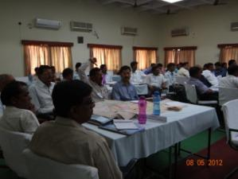
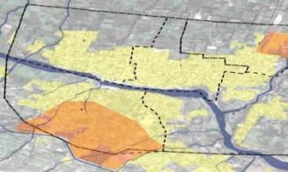
PAS
Annual service delivery profile for 419
cities in 2 States for 6 years
Performance Assessment System
National database for 1800 cities
For 18 states for 3 years
www.pas.org.in
Water supply, Waste Water, Solid waste Management & Storm Water
Old city area
Newly developing
colonies

Slide 7
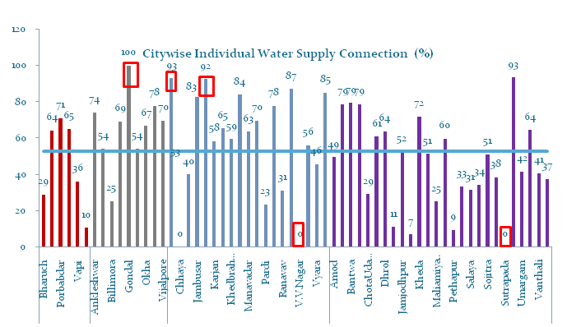
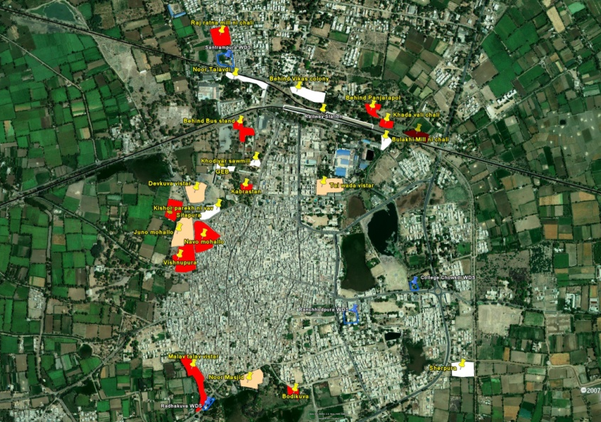
Performance Monitoring
Performance Measurement
Performance Improvement
Components of PAS project

Slide 8
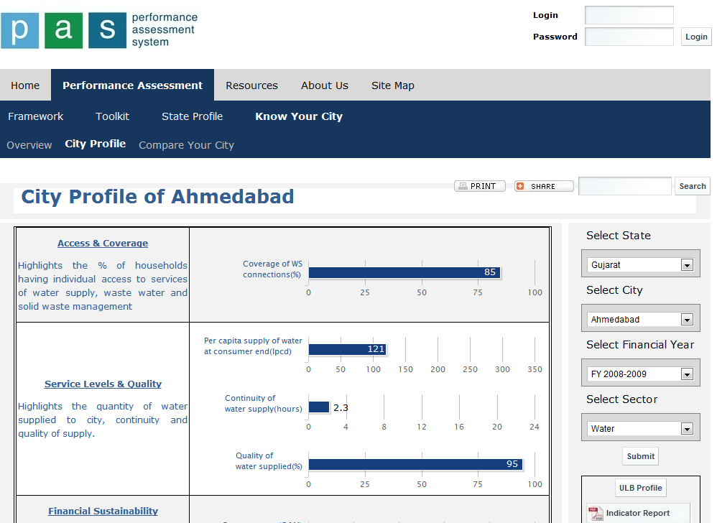
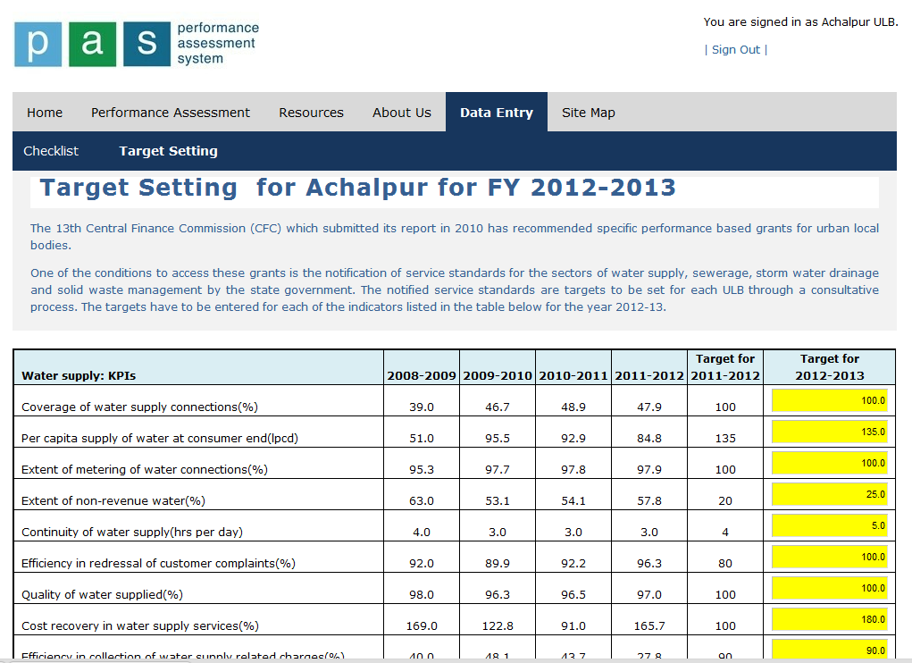
Performance Measurement Activities in Gujarat and Maharashtra
SLB-PAS web portal– with data for 6 years for all ULBs – one of largest data bases on UWSS
On-line modules for measurement and target setting
Data collection through the State Level SLB cells established at GUDM, Government of Gujarat and at AIILSG, Government of Maharashtra
Compiled SLB indicators and target, gazetted, submitted to GoI.

Slide 9
Web based measurement and monitoring
Data entry: at city level
Data storage: at state level
Shared data available at various levels
State agencies, data and analysis
Cities – data, results, analysis
Citizens
Access to analysis, results

Slide 10
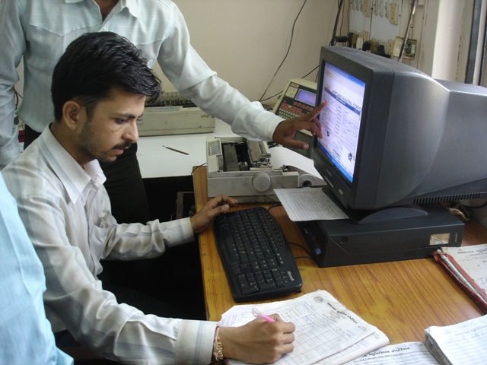
PAS-SLB web portal: Online Data Entry Module
Layers of Approval
Data submitted by City staff
Approved by: Chief Officer /Commissioner, State officials
Guidebook
For online modules in local language

Slide 11
ULB level target setting model
Target Model provides guidance for setting annual targets for SLB indicators – as per the 13th FC requirements. It helps to asses feasible targets base on trend analysis as well as ongoing capital works

Slide 12
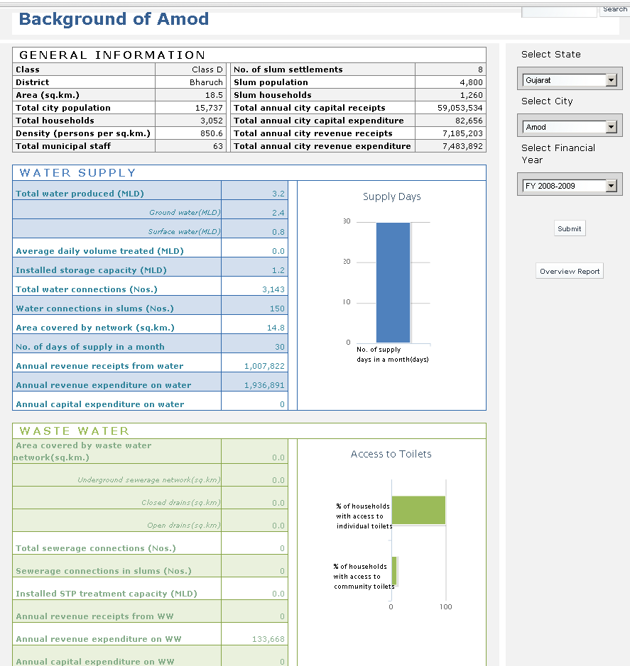
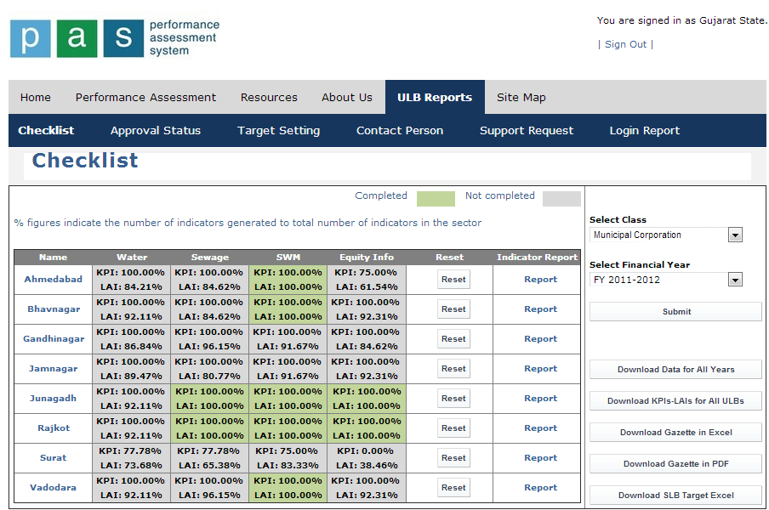
Performance Monitoring Online
City profile of all SLBs
State profile of all SLBs
Monitoring of data entry/ targets

Slide 13
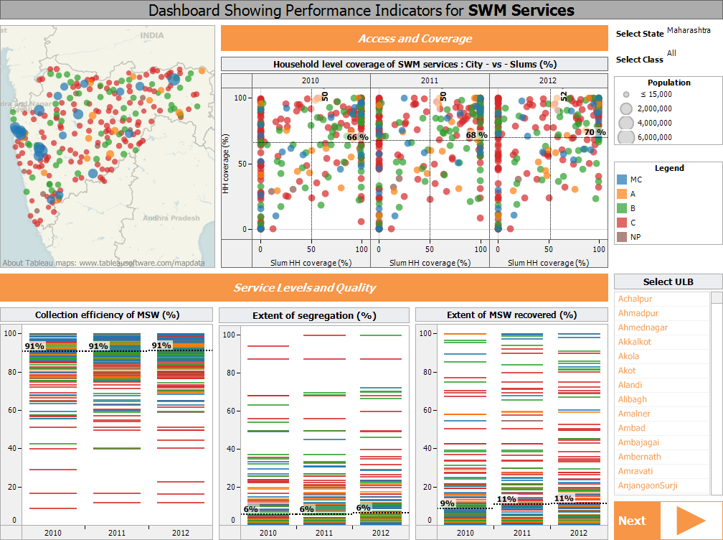
Monitoring through State level dashboards

Slide 14
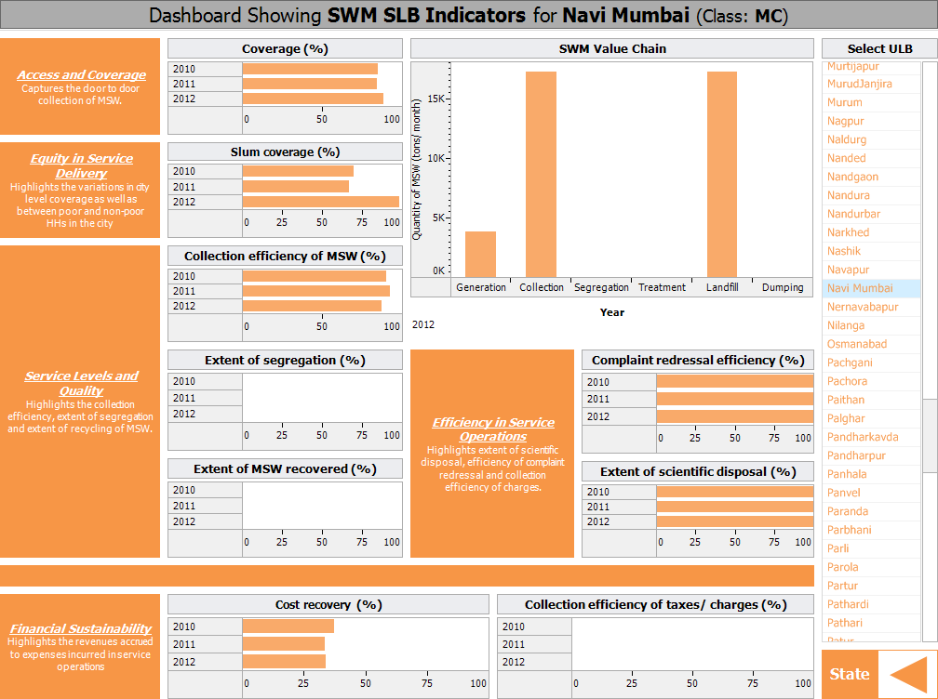
Monitoring through City level dashboards

Slide 15
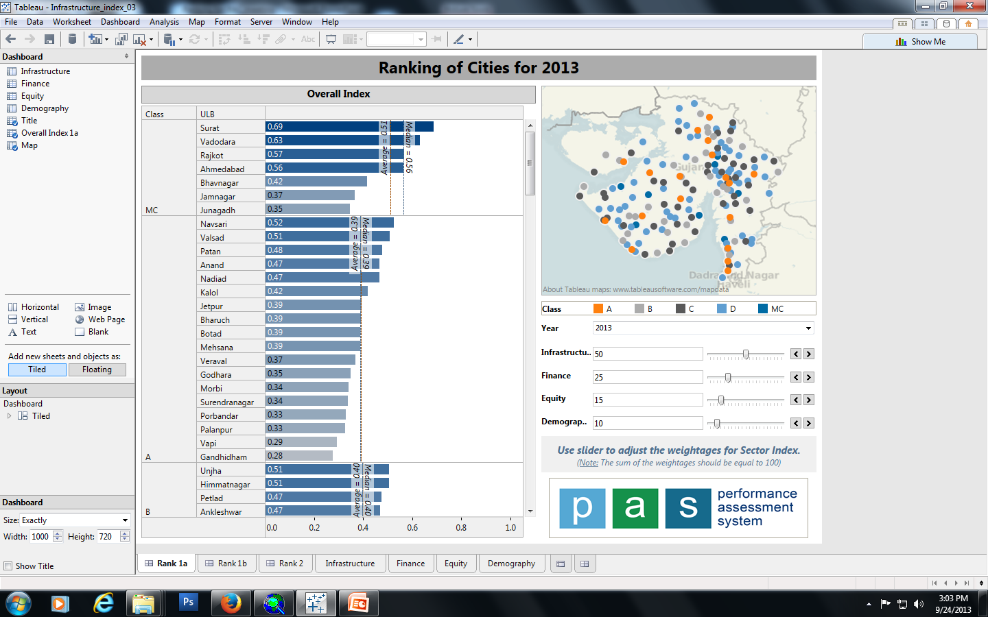
Dashboards showing ranking of cities
Urban Development Index
Demography
13 – Municipal Service Level Indicators
4 – Urban Equity Indicators
Overall Index
Dimensions
Indicators
Urban Equity
Urban Finance
Municipal Services
5 – Urban Financial and Management Indicators
3 – Demography Indicators
Similar to human development index (HDI), urban development index (UDI) was calculated using 25 indicators identified under 4 dimensions:
Demography
Municipal services
Urban finance
Urban equity
The dashboard shows class-wise ranking as per the UDI value scored by a city.
The weightage for each dimension can be changed as and when required.
It also allows the user to locate the cities on the map to identify regions that are performing good or vice-versa.

Slide 16
Integrating SLB within NeGP
MMP for Municipalities
35 JnNURM Cities as pilot
Development of e-Municipality application as a State Level Software Solution
8 modules
core Service/management functions
Model guidelines suggested a State Level Software Solution (SLSS)
Not widely followed, but Odisha MMP RfP (Dec 2013) as a SLSS
Integrating with, and adding to, existing e-Municipality modules
Bhubaneshwar (Corp.) and Puri (Muni.)
Grievances and Suggestions
Property Tax, Utilities Bills
Health Programs
/SWM
Personnel Information System
NMMP Municipality
Accounting System
Birth/ Death Certificate
Building Approvals
Procurement and Monitoring

Slide 17
Integrating PAS-SLB within NeGP
National e-governance programme
Seizing the opportunity
Relatively early stage of e-Municipality roll out
Incorporate SLB as the 9th module?
Largely aggregation from the other 8 modules; easy to do
Assessment and Improvement tools
Faster compliance and state level monitoring
Dashboards, comparisons, ranking, social audit
Ushering in Performance linked grant regime
Develop both state and city level modules
Grievances and Suggestions
Performance assessment using SLB
Property Tax, Utilities Bills
Health Programs
/SWM
NMMP Municipality
Personnel Information System
Accounting System
Birth/ Death Certificate
Building Approvals
Procurement and Monitoring

Slide 18
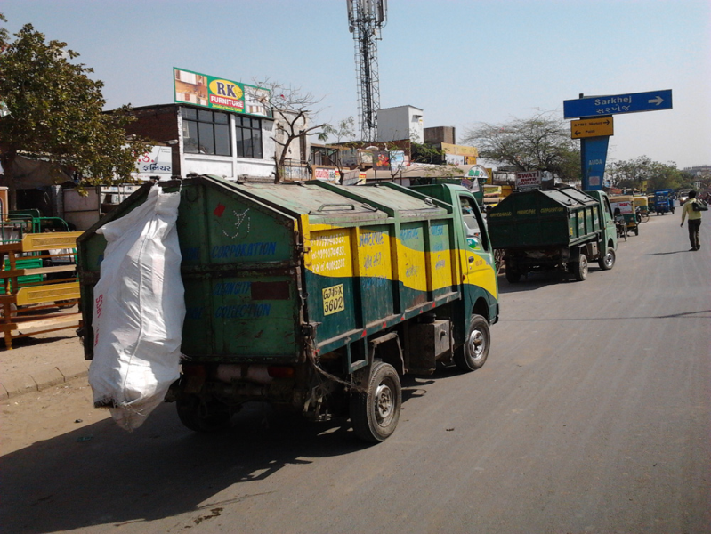
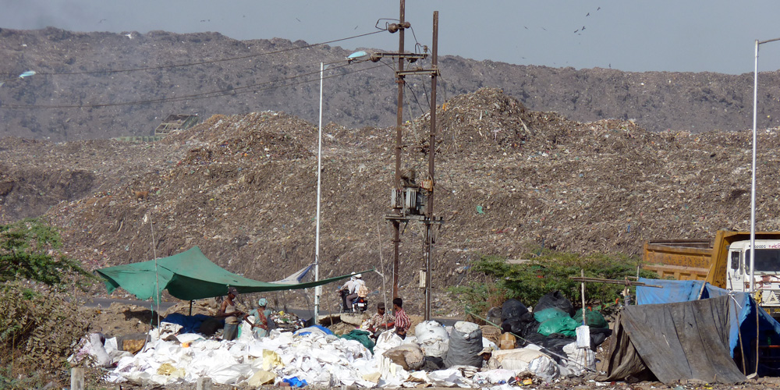
Integrating SLB in existing e-governance system of AMC
Data mapping
Map the inter – departmental data flow by TCS based on existing operations
Identify data gaps
Identify the missing data elements to capture the entire service chain of SWM
Integrated in e-governance module
Design the comprehensive module which also capture the future requirements

Slide 19
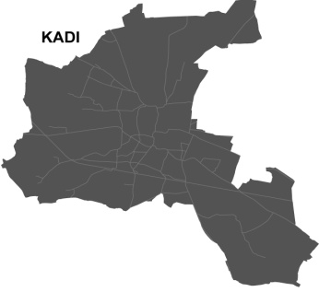
Enhancing e-Gov for SLB Mainstreaming - A Case of Kadi
City Dashboard – Conceptual
Key Statistics
Property Tax
Water Supply
Waste Water
SWM
Storm Water
Street Light
Park- Garden
Road
Complaints
Birth-Death
Accounts
Revenue
Budget
Projects
Property Tax
Complaints Redressal
Water Supply
Revenue/ Accounts
Waste Water
Street light
Solid Waste Management
Roads

Slide 20
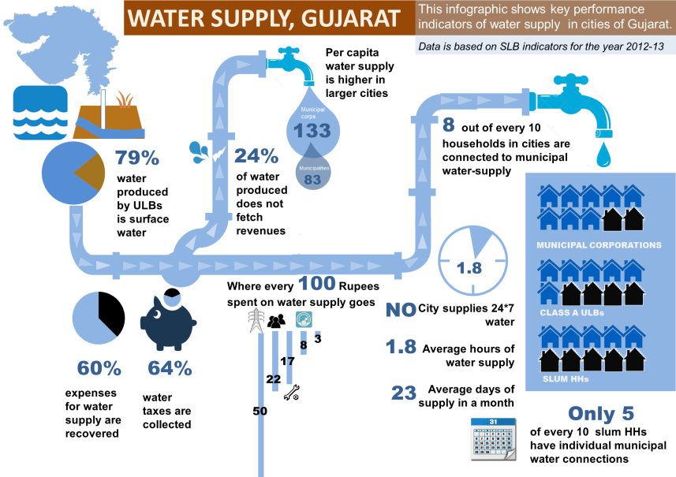
City Dashboard: Water Supply
PERFORMANCE INDICATOR: WATER SUPPLY
KADI
137 lpcd
Narmada Bulk Water
91 out of 100
14.8 ML Daily Water Production
100%
24%
3.6 ML Daily water loss
1
1 Hr
40%
70%
30
7
Rs 1596 Cost per connection
Rs 600 tariff per connection

Slide 21
Performance Improvements

Slide 22
Approach to performance improvement planning
Conventional Approach
PAS Approach
‘PROJECT’
based approach
‘SERVICE’
based approach
Oriented towards OUTPUTS
Oriented towards OUTCOMES
SUPPLY DRIVEN
Starting point is current performance – NEED DRIVEN
Focus on INDIVIDUAL PROJECTS
Focus on SECTORAL SOLUTIONS

Slide 23
Integrated approach for SERVICE IMPROVEMENT PLANNING
Focus on moving away from ‘infrastructure investment plans’ to evolving ‘service improvement plans’ which include wide set of actions for improving service delivery.
Coverage of water supply in city
Household survey
Regularize unauthorized connections
Simplifying new connection procedure
Policy for infrastructure provision in slums
Increase connections with existing distribution network
Lay new water supply distribution network
Convert stand posts/public taps into group connections
Lay internal infrastructure lines in slums
Multi-layered links between improvement actions and performance indicators,
as against big singular project proposals …
Cost recovery of water supply services
Quality of water supply services
Regularize unauthorized connections
Coverage of water supply in city
Non-revenue water
Coverage of water supply in slums
Improving service levels related to Access and coverage by varied set of interventions,
rather than just infrastructure creation …

Slide 24
Integrated approach for FINANCIAL PLANNING
Assess aggregate funding demand from all improvement actions
Financial implications of each Improvement action
Capital expenditure
Revenue generation
Operating and maintenance expenditure
Effect of inflation based on phasing
External sources of funds
Exploring funding pattern possible for each improvement action
Internal sources of funds
Exploring options to increase revenue from own income sources
Aligning both these financial streams to evolve sustainable ‘Financing Plan’
Assess financial health and extent of revenue surplus available
Municipal finances of urban local bodies
Past trends of municipal finances
Forecasting for finances for Business as Usual scenario

Slide 25
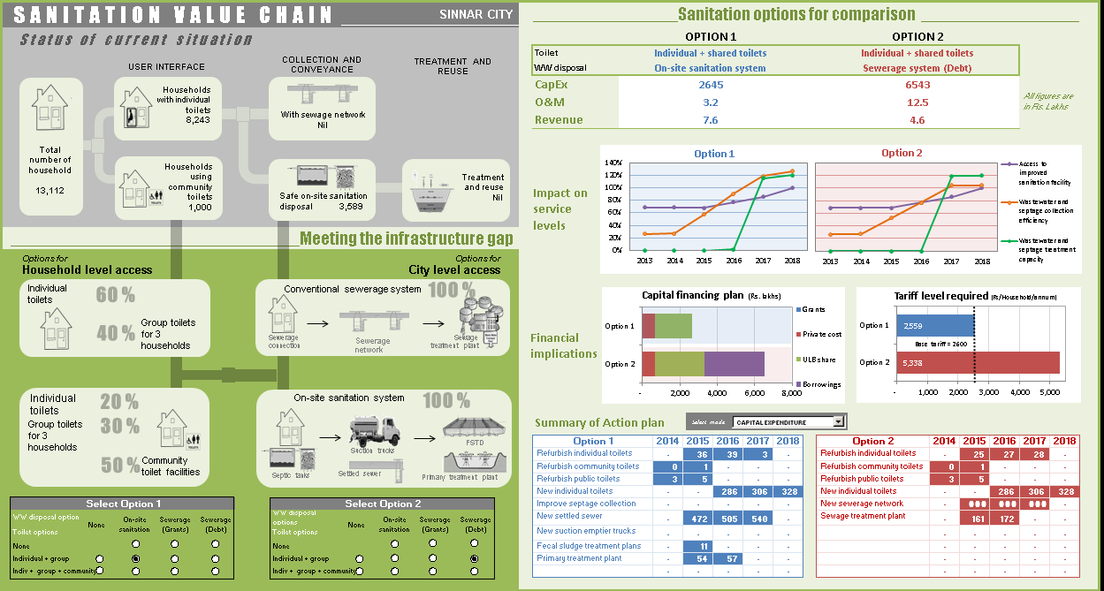
Dashboard to compare different options

Slide 26
Other Tools for Improvement Planning

Slide 27
Urban Sanitation Activities
City Sanitation Plan
Financing
Open Defecation free
Integrated Fecal Sludge Management
Work at National level –NHB, GoI, other partners
Exploring Development Impact Bonds and City Sanitation fund
Links with HFI, MFI & SHGs, Corporate Social Responsibility
PPP models
Developing Contracts
Governance & Regulation for FSM
Looking at technology options for waste treatment
Moving away from community toilets Provide on-premise or group toilet
Options for toilet technology to reduce costs
Awareness and monitoring

Slide 28
Performance Improvement support
Support for development of Improvement Plans
15 Class - A cities of Maharashtra to develop PIPs
Preliminary water audits in 10 cities of Gujarat
City Sanitation Plan in 4 small cities of Maharashtra
Information System Improvement Plan (ISIP) for Vadodara Municipal Corporation
Piloting Public Grievance Redressal System, cost recovery, services for the poor and drinking water quality surveillance in Gujarat

Slide 29
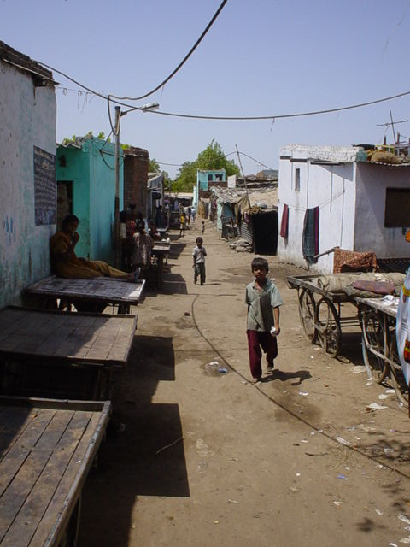
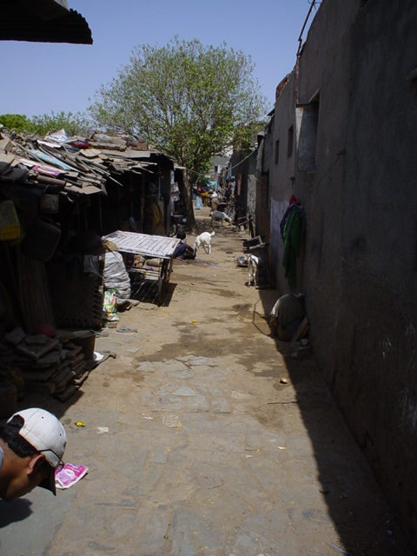
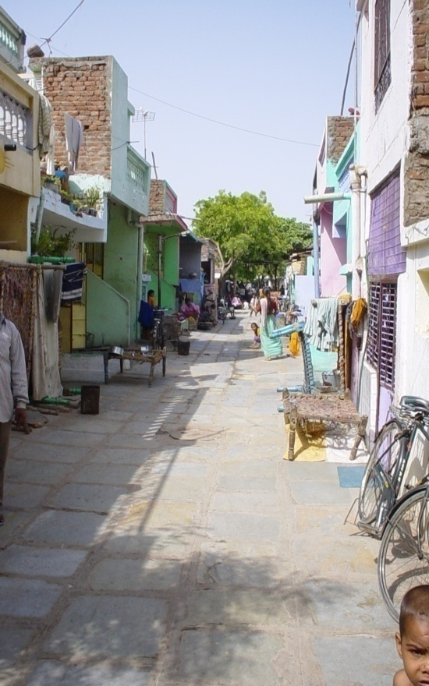
Thank You
www.pas.org.in
pas@cept.ac.in

