Slide 1


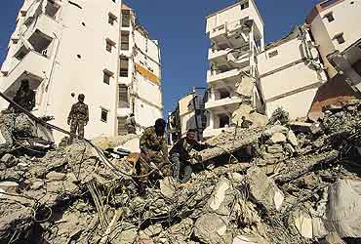
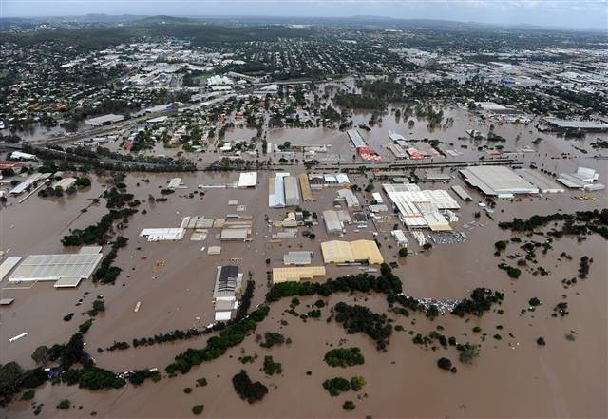

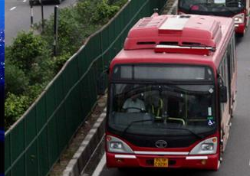
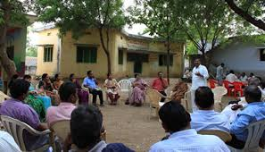
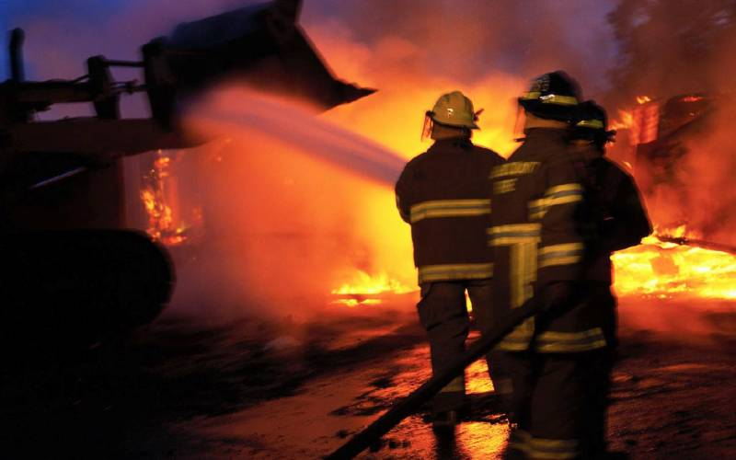
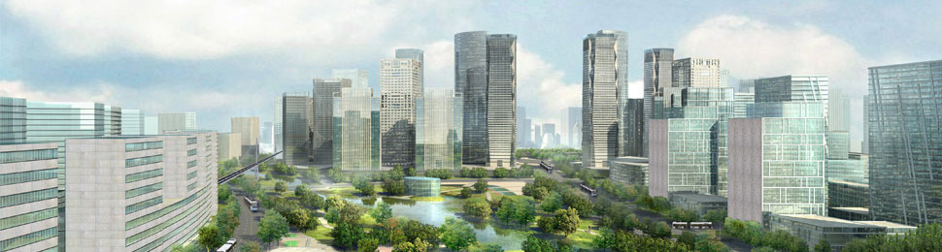
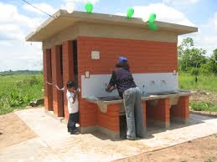
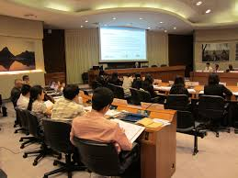
Regional Workshop
“Sustainable and Disaster Resilient Urban Development”
9th September, 2014 | Ahmedabad, Gujarat
Supported under:
Comprehensive Capacity Building Program
Ministry of Urban Development,
Government of India
Organised by :
Integrated Research and Action for Development

Slide 2

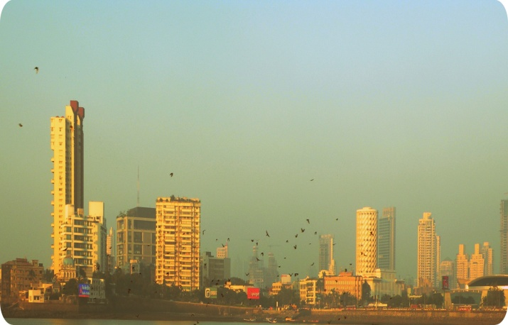
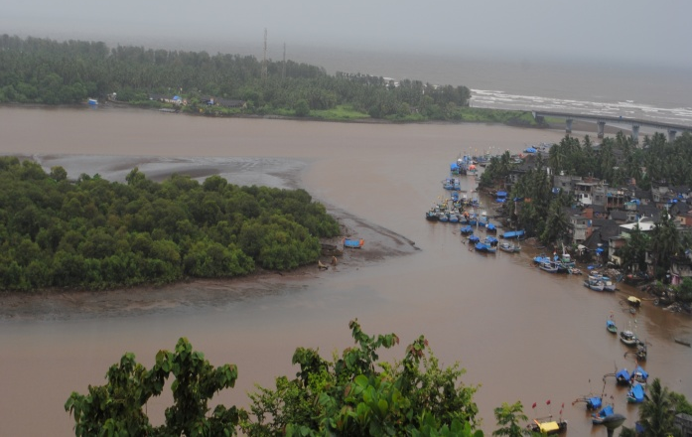
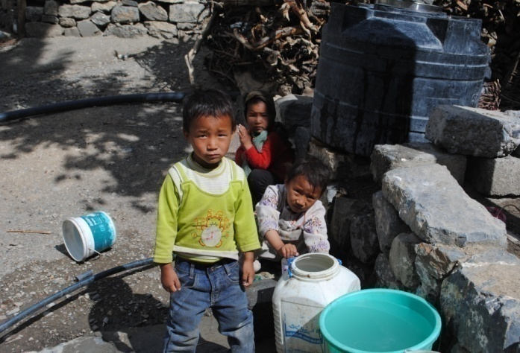
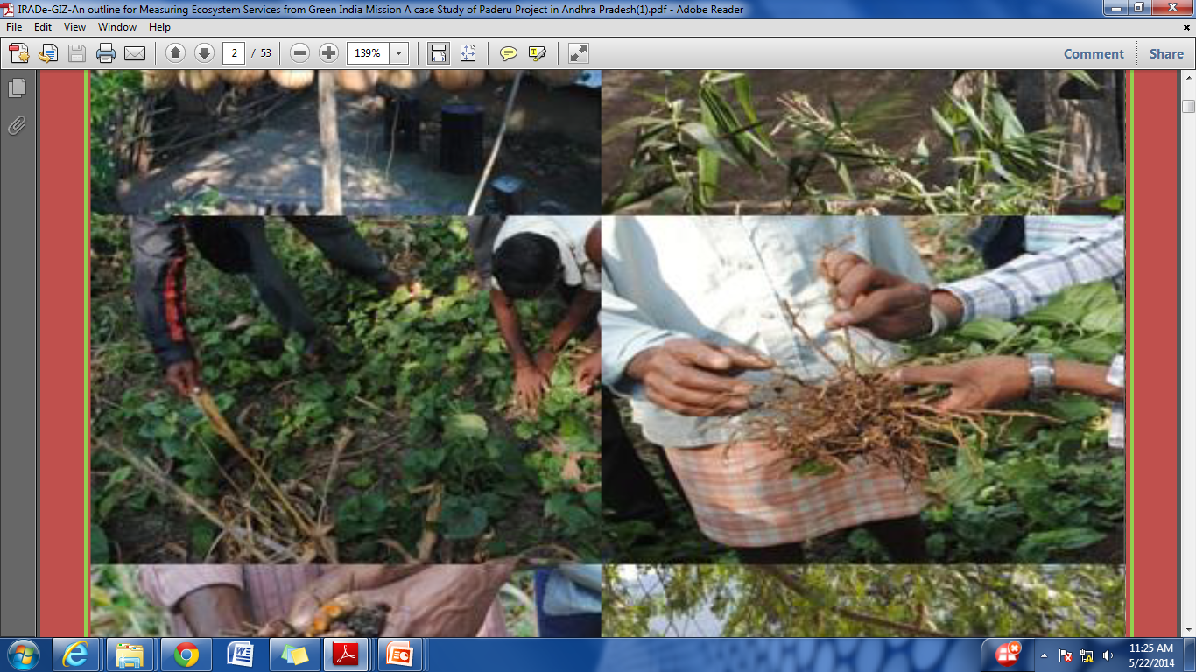
THEMATIC AREAS
Energy and Power System
Urban Infrastructure and Services
Climate Change and Environment
Poverty Alleviation and Gender
Agriculture and Food Security

Slide 3
Need for Disaster Resilience and Sustainable Cities
Today India accounts for 17 per cent of the world’s population
Urban population increased from 25.8 million to 377 million in
2011 residing in 900 cities and 4000 urban agglomerations.
Haphazard and rapid urbanization results in growing vulnerability
to environmental hazards besides that.
Increasing urban population and poverty reduces the capacity and
capability to respond to any climatic and shocks and stress
Besides that Climate change has impacted the frequency and
intensities of the natural hazards

Slide 4
Disaster events in India

Slide 5
RESILIENCE
Resilience is defined as the capability and capacity to respond to a disasters and ability to bounce back
Fully functioning and sustainable cities more likely to be resilient faster.
Disaster Risk Reduction (DRR) & Sustainable Urban Development strategies this involves measuring and monitoring of service delivery.
Resource allocation: Currently, there are no specific agencies or institutions at the city level that oversee main streaming of sustainable and disaster resilient measures ; managing climate change knowledge; or disseminating disaster related information to the general public.

Slide 6
Few recommendation to become resilient
Prioritize a climate resilient agenda : Cities need to identify priority activities that respond to their urgent needs for adaptation to climate change.
Rejuvenation of water bodies: Restoration may also help overcome the growing water scarcity also the risk of flooding can be reduced.
Drought and floods can be addressed simultaneously if we look after urban lakes, ponds and wetlands.
Expertise managing is required as green areas and parks need to be developed for water bodies management so effluents do not accumulate and water quality is maintained.
Climate conscious development and spatial planning: Development planning that incorporates climate change and variability is essential and this should apply to institutions and governments alike.

Slide 7
Selected 20 Cities from 14 States Cites for ACCCRN Project
Vulnerability profiles of twenty cities from fourteen states were prepared.
Cities were categorized on the basis of different ecosystem like coastal, hills, riverine, mixed (arid and dry) etc.
Cities with a structured framework for collecting datasets to analyze the factors impacting climate change vulnerability.

Slide 8
HIGS Framework
A framework named HIGS was developed where “H” is Hazard Exposure; “I” stand for Infrastructure, “G” for Governance and “S” for Socio-Economic variables.
H
Hazards: Physical and Meteorological Indicators
Temperature (Maximum. Minimum)
Precipitation (Maximum. Minimum)
Mean Sea Level
Frequency of Drought
Frequency of Floods
Frequency of Cyclones
S
Socio-Economic Indicators
Demographic composition (Sex-Ratio, age structure)
Slum Population (Poverty status)
Literacy rate
Migration flow
Urbanisation trend and urban sprawl
I
Infrastructure and Urban Services
Water supply
Sewerage system
Solid waste management
Storm water drainage
Transportation
Power
Housing
HIGS -Climate Responsive Urban Development
G
Governance- Institutions
Participatory
Transparency
Accountability
Response efficiency and capability
Innovative financing

Slide 9
UNDP-Review of Six Cities’ Disaster Management Plans
IRADe reviewed the City Disaster Management Plan (CDMP) of 6 cities-
Bhubaneswar
Gangtok
Madurai
Trivandrum
Shimla
Vijayawada
Assess the clarity, comprehensiveness, efficiency, appropriateness, and dissemination of disaster management measures as part of city disaster management plan
IRADe made specific recommendations and presented strategies to each city administration on addressing gaps established during the review process to update the existing CDMP

Slide 10
MoUD-Sustainable and Disaster Resilient Urban Development project is about……
Covering 10 city from different sates of India – To develop city level information based on hazards and risks, on who is exposed and who is vulnerable.
4 regional workshops: Regional workshops for finalizing strategies for disaster resilient cities.
City specific capacity building and knowledge dissemination through meeting with city stakeholders
Provide Information and awareness for qualitative self-assessments to cities in terms of disaster management preparedness
Raising awareness among government officials on natural hazard risks brings officials from a range of city level institutions
Stakeholder consultation and ownership for sensitization
Capacity building of local government officials and city stakeholders including institutions, organizations etc.

Slide 11
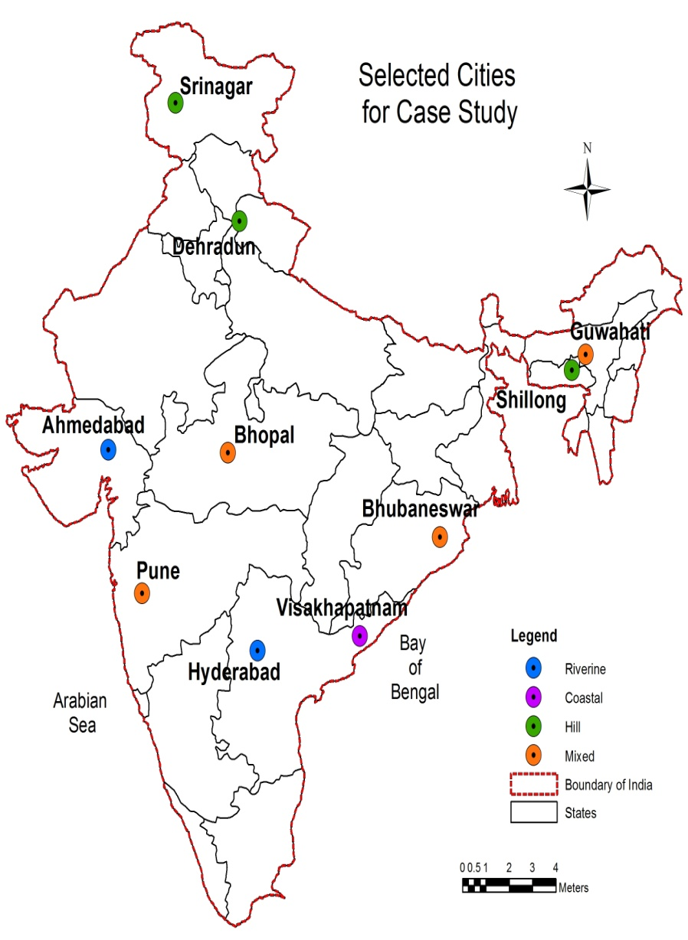
SELECTED CITIES
10 Cities selected on the basis of different ecosystems and regions
East India- Guwahati, Shillong, Bhubaneswar
West India- Pune, Ahmadabad, Bhopal
South India- Vishakhapatnam, Hyderabad
North India- Dehradun, Srinagar

Slide 12
PROCESS AND FRAMEWORK
Methodology
Study of existing Literature on Disaster Management , Urban Development
Basic City Profile
Share with ULB’s
City Visits
Updated data
City Profile
City Management and Governance
Disaster timeline and Hazard profile
Updated City profile
Financial Resources
Infrastructure Status and land use
Assessment of parameters w.r.t. Disaster resilience
Analysis
Draft report ready
Dissemination of finding through workshop
Shared with ULB’s
Shared with MoUD
Final Report
Comments Incorporated

Slide 13
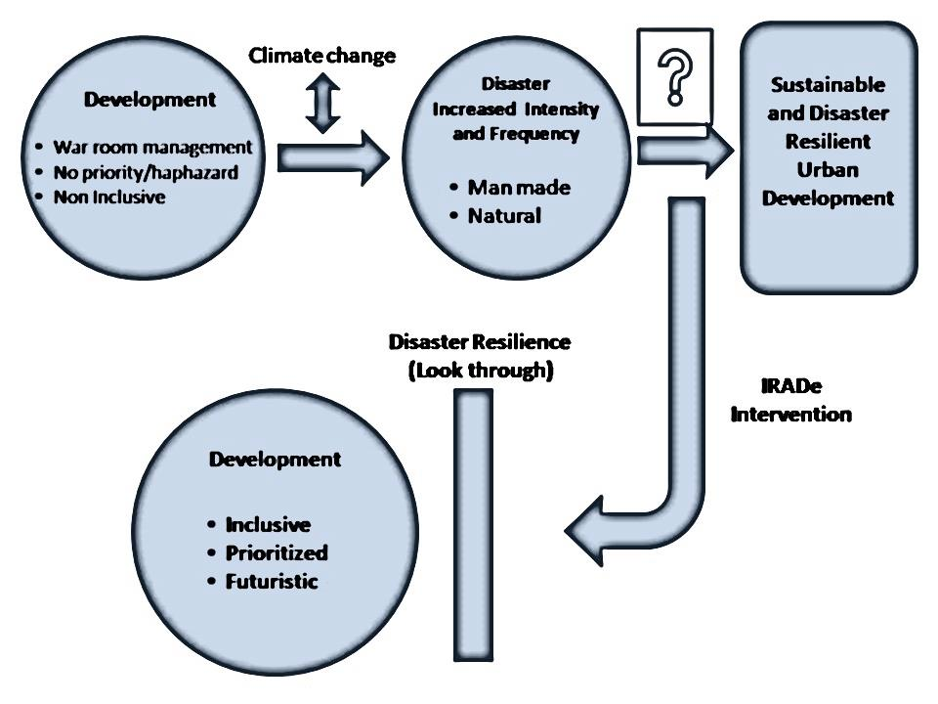
Thought Put forth by IRADe through this project

Slide 14
Process for Preparation of Report
City Profile
Natural Hazard Profile
Infrastructure status and Land Use
City Management and Governance
City Visits report – Observations
Resilience Assessment and Analysis
Recommendations and Concluding remarks

Slide 15
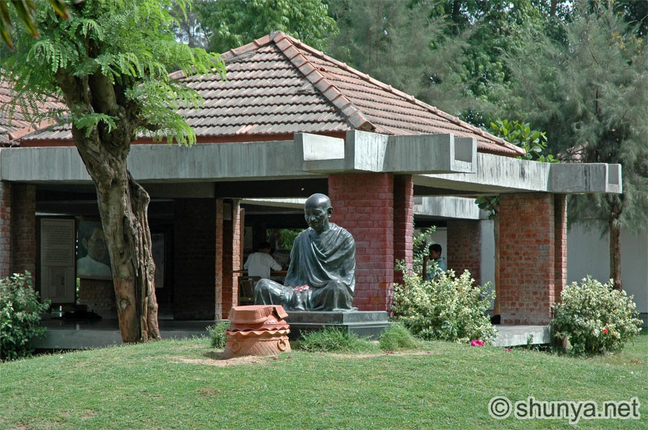
Case Study : Ahmedabad
Demography and Urbanisation
5th largest city and 7th largest urban agglomeration of India
Approximately 13% of the total population of the city lives in slums in the year 2011
Total Population AUDA: 6,352,254, 2011 census
Decadal Growth rate (2001-2011):25%
Total Slum population(AMC): 7.28 lakh (2011 census)
Literacy rate: 86%2011 census)
Height from mean sea level: 49 m (MSL)(CDP, Ahmedabad)
Topography: Riverine

Slide 16
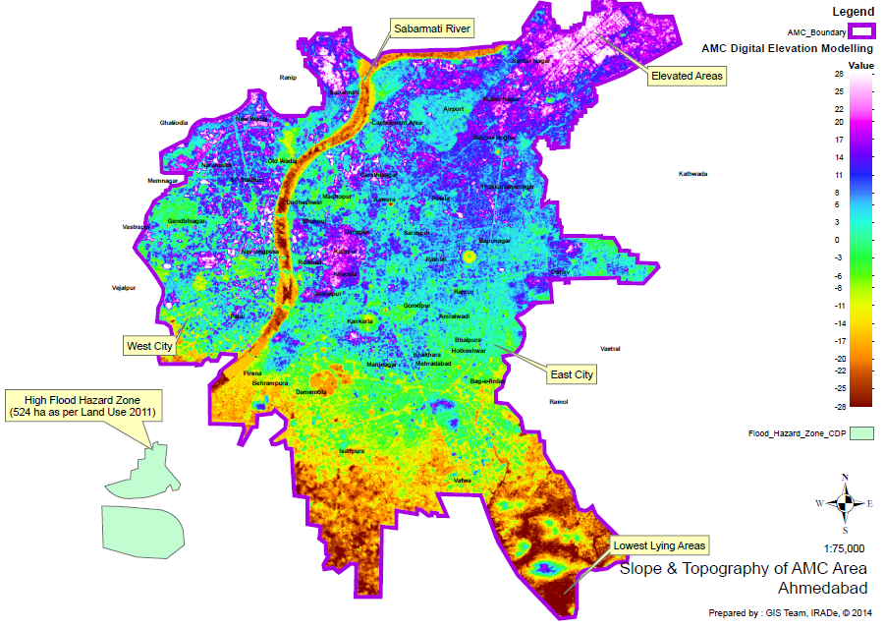
Exposure to Hazards
High exposure to a number of disasters with the highest proneness being to earthquakes, floods and heat waves.
Urban flooding
Reasons :
Heavy rainfall
Topography with less slope
Poor drainage network
Chocked natural drainage system
Slope and Topography of AMC Area

Slide 17
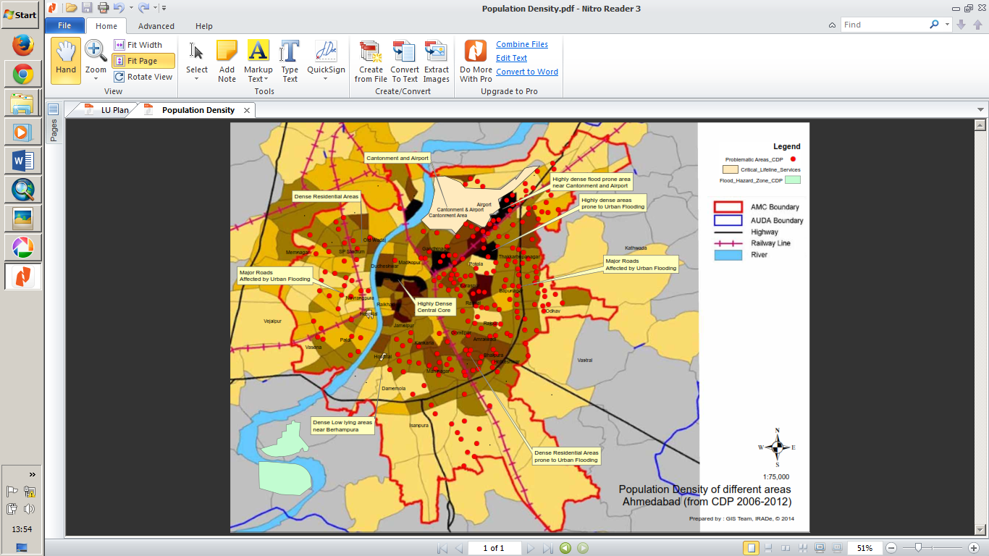
KEY FINDINGS
The storm water drains cover only 23% of the roads.
The newly acquired areas of AMC do not have storm water drainage system because of which areas get flooded.
The central core of the city does not face any water logging issues.
Many old structures where structural quality needs regular assessment.
Residential land use is proposed to be increased in AMC areas which can put more pressure on land and infrastructure services
Population Density and Locations Exposed to Flooding in Past

Slide 18
Infrastructure Status in the City
Status of Service Level Benchmark in Ahmedabad City
 |  | AHMEDABAD
VARIABLES | BENCHMARK | 6,352,254 (POPULATION 2011-UA)
WATER SUPPLY |  | Low | Medium | High
Coverage of water supply | 100 | 90%
Per capita water supply | 135 LPCD | 140-160 lpcd
SEWERAGE SYSTEM
Coverage of waste water network services | 100 | 85%
Coverage of toilets | 100 | NA
SOLID WASTE MANAGEMNT SYSTEM
Household coverage to collect MSW | 100% | 100%
Efficiency of collection of MSW | 100% | 65%
STROM WATER DRAINAGE
Coverage of drainage system | 100 | 32%
Incident of water logging/flooding | ZERO | NA
Data Source: Infrastructure condition assessment is made by comparing SLB data for the cities to the present status of the infrastructure in the city. Data for the other variable is collected from the municipal corporation and city development plan. Other sources are city disaster management authority and city department of urban development.
Low: safe
Medium: need improvement
High: critical

Slide 19
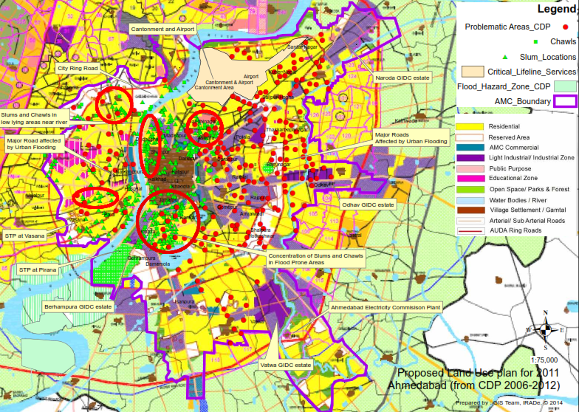
Infrastructure Status in the City

Slide 20
Disaster Preparedness and Recovery Plan
Ahmedabad city awareness toward disaster resilience and capacity building is appreciable especially after the Bhuj earthquake the state administration has taken many steps in this context.
The Government of Gujarat for the first time in India enacted the Gujarat Disaster Management Act, 2003.
There is a high influence of State Disaster Management Authority on the response and recovery plan for the city. The city administration has police , fire bridge and a control room to handle.
The city administration has implemented the building codes in the cities that are earthquake prone.
In 2013 the state government also launched Heat Action Plan for the city considering the impact of heat waves in the city.
Budget planning done based on past years data/actual requirements
Professional asset valuation and transparent and speedy payment systems through ECS/RTGS to suppliers and contractors.

Slide 21
Vulnerability Assessment Matrix for Ahmedabad
Vulnerability Assessment Matrix for Ahmedabad
Sl. No | Variables | Low | Medium | High | Index Details and Remarks
1 | Socio economic conditions
1.1 | Population Growth |  |  | ✓ | Decadal Growth 25% (2001-2011)
1.2 | Percentage of slum population |  |  | ✓ | 13 %
2 | Infrastructure condition ( basic services)
2.1 | Water supply ( lpcd) | ✓ |  |  | 140-160 lpcd(FY 2012-13)
2.2 | Sewerage system coverage |  |  | ✓ | 85%
2.3 | Solid waste management system coverage | ✓ |  |  | 100%
2.4 | Drainage ( coverage & water logging incidences) |  |  | ✓ | 32% of storm water drain coverage
3 | Governance and Institutional Framework
3.1 | Disaster response system | ✓ |  |  | State Emergency Operation Centre present
3.2 | City Disaster Management department | ✓ |  |  | Structure in place with assigned responsibilities
3.3 | Dedicated persons to handle and update DRR data | ✓ |  |  | Not mentioned clearly. This affects future prepardness
3.4 | DRR in urban planning | ✓ |  |  | A State Disaster Management Plan is made
3.5 | Approach top down or Bottom up approach |  | ✓ |  | Presence of both approach brings clarity in functioning during disasters

Slide 22
4 | Investments and Intervention to improve urban services
4.1 | Investments in water sector (%) |  | ✓ |  | 2% of total JnNURM funds sanctioned for water supply projects. Project completed
4.2 | Investments in sanitation sector (%) | ✓ |  |  | 20% of total JnNURM funds sanctioned for 6 sewerage projects. 5 completed and remaining one 70% physical progress
4.3 | Investments in solid waste sector (%) | ✓ |  |  | 4% of total JnNURM funds sanctioned for SWM projects.
4.4 | Investments in storm water drainage sector (%) | ✓ |  |  | 11% of total JnNURM funds sanctioned for SWD projects
4.5 | Investments in BSUP (%) |  | ✓ |  | 14% of total JnNURM funds sanctioned for housing for poor
4.6 | Is there any dedicated budget in place for DRR |  | ✓ |  | State Disaster Response Fund present to carry out Emergency Response & Relief activities after any disaster.
4.7 | Incentive to house owners, business houses and public sector who comply to DRR |  |  |  | No information found
4.8 | Budget for low income group to make them disaster resilient |  |  |  | No information found

Slide 23
5 | Adaptation Strategies in the Cities
5.1 | Human Resource-Trained workforce to community interaction, community awareness initiative etc | ✓ |  |  | There is State Disaster Response Force in place who organizes community interaction, community awareness initiative etc
5.2 | Early warning system |  | ✓ |  | Present for cyclones, tsunami, not for earthquakes
5.3 | Updated previous disaster data base | ✓ |  |  | In State Disaster Management Plan available for the whole state; city specific not present
6 | Mitigation Actions by Category
6.1 | Emergency Services- like Dedicated control room for information dispensation and coordination and Necessary equipments in place and functioning | ✓ |  |  | State Emergency Operation Centre (SEOC) in place. Equipment's/vehicles provided by GSDMA to Ahmedabad.
6.2 | Building codes for current and future construction | ✓ |  |  | Building bylaws modified in 2007 to include seismic parameters, rain water harvesting and solar energy utilization
Data Source: Infrastructure condition assessment is made by comparing SLB data for the cities to the present status of the infrastructure in the city. Data for the other variable is collected from the municipal corporation and city development plan. Other sources are city disaster management authority and city department of urban development. Low: Least vulnerable, Medium: vulnerable, High: Most vulnerable

Slide 24
Recommendations
Disaster risk reduction and building resilience should be integrated into city planning to cope with the number of hazards the city is exposed to.
Database management : A disaster timeline for the city with details regarding its impact on human, animal, agriculture and infrastructure should be maintained.
authorities should aim to make its citizens more resilient to impacts at the local level.
A City resilience plan should be prepared for Ahmedabad considering its exposure to hazards and potential to emerge as a major metropolitan city.
Rain water recharge should be made mandatory to revive depleting ground water levels

Slide 25
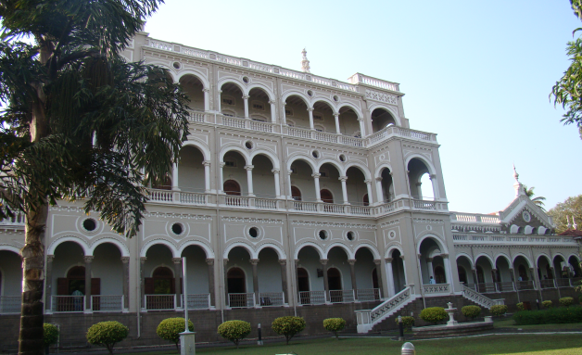
CASE STUDY –PUNE CITY
Demography and Urbanisation
Pune city is the second largest metropolitan city in Maharashtra .
It is the 8th largest metropolitan city of India.
The growth rate in the core part of the city is about 2 – 2.5% per year.
The annual growth rate in peripheral wards is about 4.4%.
The total number of slums in Pune are 564 out of which 353 (i.e. 64%) are notified by the municipal body and 211 (36%) are undeclared or un-notified (PMC).
These areas lack basic services and amenities that make the slum dwellers exposed to natural hazards
Population: 5,049,968 (2011)
Decadal Growth rate (2001-
2011): 30.34% compared to
population as per 2001
Total Slum population:
6,90,545
Literacy rate:91.61
Sex ratio: 945 per thousand
males
Height from mean sea level
560 meters (MSL)
Topography: Inland city

Slide 26

EXPOSURE TO HAZARDS
A ward wise disaster exposure and risk areas in Pune show that most of the wards are
exposed to hazards like earthquake, floods, landslides due to construction and fire accidents
Ward Wise Disaster Exposure and Risk Areas in Pune
Name of the Wards | Floods | Earthquake | Landslides | Fire & Industrial
Aundh | H | M | H | L
Kothrud | M | M | H | M
Ghole road | H | M | L | L
Warje – Karve Naga | H | M | M | M
Dhole Patil Road | H | L | L | L
Hadapsar | H | H | M | M
Nagar Road | L | L | L | H
Sangamwadi | L | L | L | H
BhavaniPeth | L | H | L | H
Kasba-VishramBaag | L | H | L | H
Sahakar Nagar | L | H | L | M
Tilak Road | M | H | L | M
Bibvewadi | L | H | L | L
Dhankawadi | L | M | H | L
Source: Pune City Disaster Management Plan-2012 Note: The exposure to risk is categorized in high (H), medium (M) and low (L). The darker shades of the color represent high risk, the lighter shade represents low risk.

Slide 27
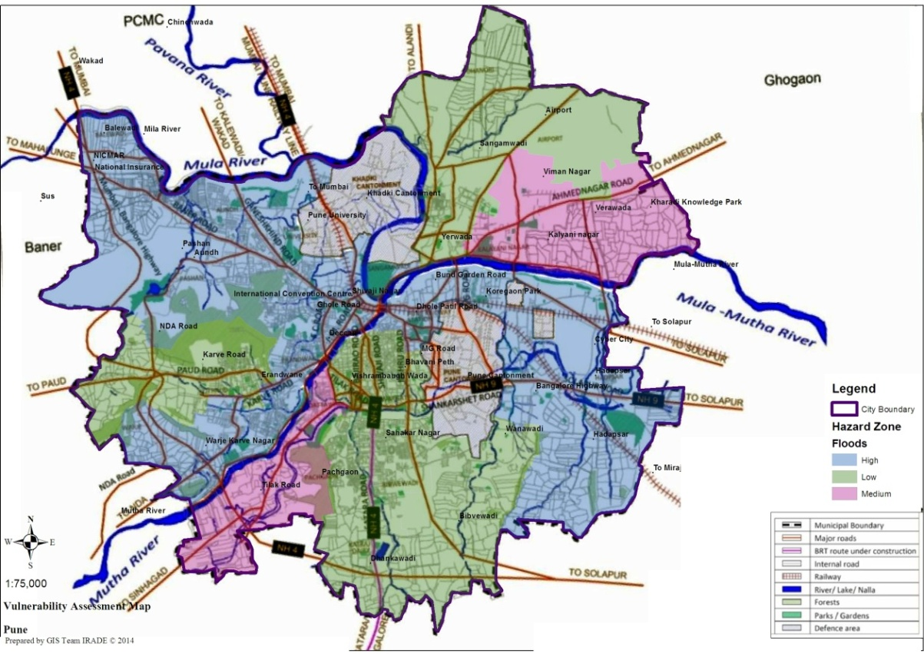
KEY FINDINGS
Floods have played a critical role in shaping Pune’s character to a great extent
The ongoing urbanization will result in more run- off
The city is also surrounded by dams and overflowing of these dams is the main cause of flooding in Pune
Low lying areas are the major affects of floods. The probability of floods is moderate and intensity is low to moderate.
Flood Vulnerability Assessment Map
Pune has always been known for its good climate, but in the last few years the city has been receiving heavy rainfall which has given rise to yearly floods in Pune.

Slide 28
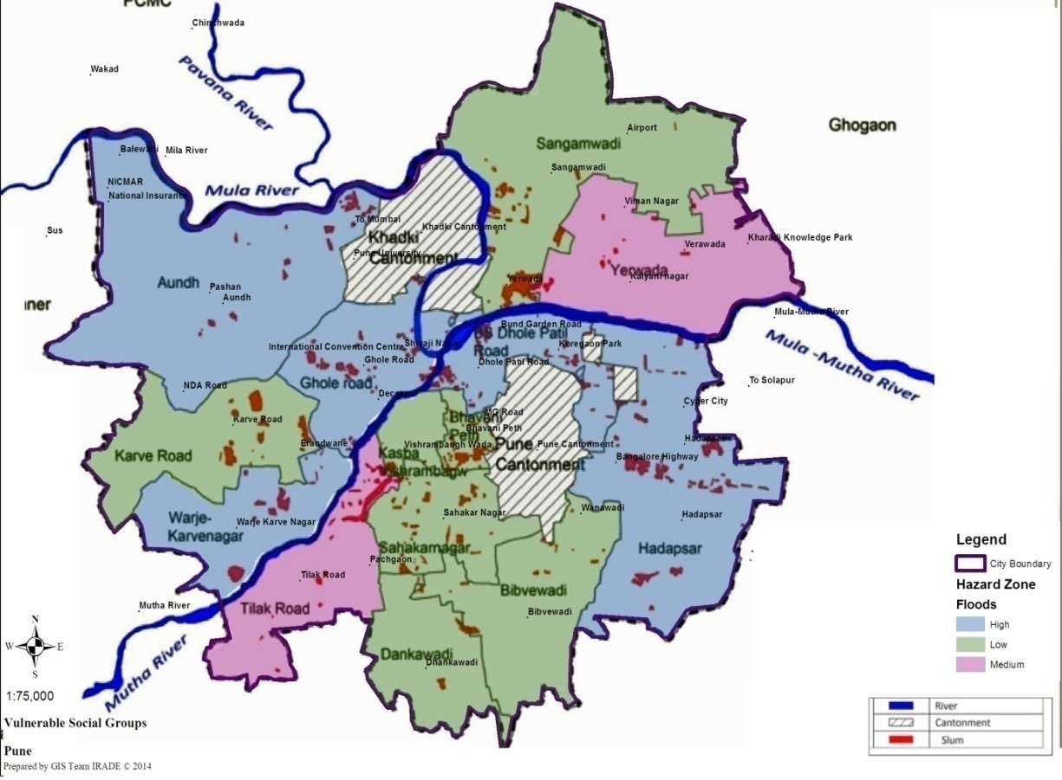
Location of slums and flood zones in Pune
There was a net increase of around 5.33% in the built up area
In most of the construction about 40 to 50 % in some wards are weak structures and houses are old types, located in slums
Around 40% of the population lives in slums
These slums lack basic services
The coverage of drains to roads is only 52 percent in the city
Adequacy of the cities treatment capacity of waste water is just 71% which indicates that 29% of wastewater is still untreated and disposed into various streams in the city

Slide 29
Infrastructure Status in the City
Status of Service Level Benchmark in Pune City
 |  | PUNE
VARIABLES | BENCHMARK | 5,049,968 (POPULATION 2011-UA)
WATER SUPPLY |  | L | M | H
Coverage of water supply | 100 | 94.2
Per capita water supply | 135 LPCD | 194 lpcd
SEWERAGE SYSTEM
Coverage of waste water network services | 100 | 97
Coverage of toilets | 100 | 97
SOLID WASTE MANAGEMNT SYSTEM
Household coverage to collect MSW | 100% | 52
Efficiency of collection of MSW | 100% | 100
STROM WATER DRAINAGE
Coverage of drainage system | 100 | 55
Incident of water logging/flooding | ZERO | 52
Data Source: Infrastructure condition assessment is made by comparing SLB data for the cities to the present status of the infrastructure in the city. Data for the other variable is collected from the municipal corporation and city development plan. Other sources are city disaster management authority and city department of urban development.
Low: safe
Medium: need improvement
High: critical

Slide 30
Disaster Preparedness and Recovery Plan
The Government of Maharashtra (GoM) has established a mechanism for disaster preparedness and mitigation by integrating science and technology with communication network facilitates.
A State Disaster Management Action Plan to support and strengthen the efforts of the district administration.
At the apex of the responsibility structure for response plan PMC/PCMC was given charge managing the head of technical team for fire, city engineers and police control room/ officers.
The management plan for disaster is fully functioning and is one of the best initiatives take by the municipal government at ward level
DPR is prepared for Water supply considering the prepared covering augmentation
ULBs have trained staff
The revenue sources of the Corporation may be broadly classified as internal or operating income and external receipts.

Slide 31
Vulnerability Assessment Matrix for Pune
Vulnerability Assessment Matrix for Pune City
Sr.No | Variables | Low | Medium | High | Index Details and Remarks
1 | Socio economic conditions
1.1 | Population Growth |  |  | ✓ | Decadal Growth 30.34% in 2001
1.2 | Population density in the city (Percentage of slum population) |  |  | ✓ | Approximately 40% of the total population
2 | Infrastructure condition ( basic services)
2.1 | Water supply ( lpcd) | ✓ |  |  | 194 lpcd FY 2012-13
2.2 | Sewerage system coverage | ✓ |  |  | 97%
2.3 | Solid waste management system coverage |  | ✓ |  | 52.7%.
2.4 | Drainage ( coverage & water logging incidences) |  | ✓ |  | road drainage network is only 52 percent.
Data Source: Infrastructure condition assessment is made by comparing SLB data for the cities to the present status of the infrastructure in the city. Data for the other variable is collected from the municipal corporation and city development plan. Other sources are city disaster management authority and city department of urban development. Low: Least vulnerable, Medium: vulnerable, High: Most vulnerable

Slide 32
3 | Governance and Institutional Framework
3.1 | Disaster response system | ✓ |  |  | Fully functioning emergency operation centre present
3.2 | City Disaster Management department | ✓ |  |  | Structure in place with assigned responsibilities
3.3 | Dedicated persons to handle and update DRR data |  | ✓ |  | Done but not regular
3.4 | DRR in urban planning |  | ✓ |  | Mixed
3.5 | Approach top down or Bottom up approach | ✓ |  |  | Documented and Implemented
4 | Adaptation Strategies in the Cities
4.1 | Prevention( preparedness drills/mock drills, regular training) | ✓ |  |  | reports of activity are available
4.2 | Human Resource-Trained workforce to community interaction, community awareness initiative etc | ✓ |  |  | Yes through workshops/mock drills/trainings
4.3 | Early warning system and rehabilitation | ✓ |  |  | Present for floods
4.4 | Updated previous disaster data base |  | ✓ |  | Some events are documented in the CDMP

Slide 33
5 | Mitigation Actions by Category
5.1 | Emergency Services- like Dedicated control room for information dispensation and coordination and Necessary equipment's in place and functioning | ✓ |  |  | Emergency operation centre is in place
5.2 | Natural Resource Protection |  | ✓ |  | executed
5.4 | Building codes for current and future construction | ✓ |  |  | Building code to include seismic parameters, rain water harvesting
Data Source: Infrastructure condition assessment is made by comparing SLB data for the cities to the present status of the infrastructure in the city. Data for the other variable is collected from the municipal corporation and city development plan. Other sources are city disaster management authority and city department of urban development.
The city is equipped with the technology and knowledge in the field of disaster resilience.
The city has detailed disaster management plan and a response system.
E-governance and improving efficiency of delivery system of urban services is also considered widely

Slide 34
Recommendations
Assessment of city growth and infrastructure needs to be carried out.
Detailed feasibility/engineering studies should be carried out for new projects.
Assigning of priorities within the constraint of available financial resources should be taken care of.
The growth in population is also likely to exacerbate the already stressed modes of public transport and will impact other services; hence, planned efforts are required to direct the growth in the right direction.
Government should explore more options in land use planning and suitability.
Strict enforcement of Development Control (DC) rules must be observed.
The major issue in the city is the database management system for past disaster events. There is a need to maintain and update the data for each event regularly.
Physical development and growth are haphazard and uncontrolled. The Development Plan needs to be implemented correctly and reserved lands have to be used for specified purposes.

Slide 35
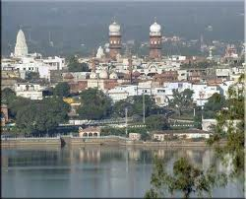
CASE STUDY BHOPAL
Demography and Urbanisation
Population of the city increased from 1.02 lakhs in 1951 to 17.96 lakhs in 2011.
Bhopal is a major centre of industries in the region.
Total Population (Census of India-2011):883,381 (2011)
Population Decadal Growth: 25.33% (2001– 2011)
Total Slum population: 4,79,699 (Census 2011)
Literacy rate: 85.24 %
Sex ratio:911 females per thousand males.
Height from mean sea level (MSL): 427 m (MSL)
Topography: Terrain with several hilltops or plateaus

Slide 36
EXPOSURE TO HAZARDS
Bhopal, lie in Zone II, where the maximum expected intensity is VI (MSK).
The city has experienced flooding of upper lake in 1973
In 2006 City experienced 32.1 cm rains within less than 15 hours, a record in 80 years leading to loss of life and property
The city has experienced severe water crises during 2002 & again in 2009 due to drying up of all lakes in the city.
The future water demand projection depending on the population growth rates indicates that water demand in year 2031 for Bhopal city would increase to 536 MLD.

Slide 37
KEY FINDINGS
Bhopal city is exposed to the natural hazards like earthquake, floods, water scarcity, and urban floods.
The presence of a large number of industries also makes the city vulnerable to industrial disasters.
The infrastructure in terms of solid waste management and storm water drainage should be improved as the current coverage is only 47% and 60% respectively.
Efficient drainage system would minimize the chances of urban flooding which the city has already experienced twice in the recent years.
Integrated project management covering disaster resilience, adaptation, environment and sustainability, is highly required as the city is being upgraded on all fronts.

Slide 38
Infrastructure Status in the City
Status of Service Level Benchmark in Bhopal City
 |  | BHOPAL
VARIABLES | BENCHMARK | 1,883,381 (POPULATION 2011-UA)
 |  | L | M | H
WATER SUPPLY
Coverage of water supply | 100 | 58%
Per capita water supply | 135 LPCD | 150 lpcd
SEWERAGE SYSTEM
Coverage of waste water network services | 100 | 12%
Coverage of toilets | 100 | 81%
SOLID WASTE MANAGEMNT SYSTEM
Household coverage to collect MSW | 100% | 47%
Efficiency of collection of MSW | 100% | 81%
STROM WATER DRAINAGE
Coverage of drainage system | 100 | 60%
Incident of water logging/flooding | ZERO | 0%
Data Source: Infrastructure condition assessment is made by comparing SLB data for the cities to the present status of the infrastructure in the city. Data for the other variable is collected from the municipal corporation and city development plan. Other sources are city disaster management authority and city department of urban development.
Low: safe
Medium: need improvement
High: critical

Slide 39
Disaster Preparedness and Recovery Plan
An institutional mechanism needs to be developed which brings all agencies on a common platform such that overlaps, departmental delays, duplication is reduced and faster delivery of projects is ensured
The city lack any formal implementation of the disaster management plan.
It is found that SDMA has not developed City disaster management plan nor disaster preparedness manuals for schools, apartments, govt. offices, Hospitals and commercial buildings.
Recovery of expenditure rendered to public through tax and bills are on lower side and needs transparent and efficient mechanisms.
The State Disaster Management Authority (SDMA) policy statement there is discussion of dedicated funds for the disaster management activity but whether the funds are made available and utilized in capacity building and awareness exercises is not mentioned.

Slide 40
Vulnerability Assessment Matrix for Bhopal
Vulnerability Assessment Matrix for Bhopal City
Sl.No | Variables | Low | Medium | High | Index Details and Remarks
1 | Socio economic conditions
1.1 | Decadal growth % of population |  |  | ✓ | As per census 2011 the decadal growth % is 25.33%
1.2 | Population density in the city (hazard prone areas/slum population percentage) |  |  | ✓ | Slum population is approximately 26%
1.3 | Percentage of urban poor population (BPL) |  |  | ✓ | As per census 2001 BPL population of the city above 50%
2 | Infrastructure condition ( basic services)
2.1 | Water supply ( lpcd) | ✓ |  |  | Per capita water supply is 150 lpcd
2.2 | Sewerage system coverage | ✓ |  |  | Sewerage system coverage 81%
2.3 | Solid waste management system coverage |  | ✓ |  | 47% of the households were covered under solid waste management system
2.4 | Drainage ( coverage & water logging incidences) |  | ✓ |  | Drainage coverage in the city was 60%, no water logging incidences occurred
Data Source: Infrastructure condition assessment is made by comparing SLB data for the cities to the present status of the infrastructure in the city. Data for the other variable is collected from the municipal corporation and city development plan. Other sources are city disaster management authority and city department of urban development.
Low: Least vulnerable, Medium: Vulnerable, High: Most vulnerable

Slide 41
S.No | Variables | Low | Medium | High | Index Details and Remarks
3 | Governance and Institutional Framework
3.1 | Disaster response system (Emergency Operation Centre present physically) |  |  | ✓ | Emergency Operation Centre not present physically
3.2 | City Disaster Management department |  |  | ✓ | Not present
3.3 | Dedicated persons to handle and update DRR data |  |  | ✓ | No information found
3.4 | DRR in urban planning |  |  | ✓ | Not done
3.5 | Approach top down or Bottom up approach |  |  | ✓ | District Disaster Management plan doesn’t exist only a document for industrial disaster management plan is there.
4 | Investments and Intervention to improve urban services
4.1 | Investments in water sector (%) of allocated budget spent |  | ✓ |  | Rs 43137.94 lakhs allocated , 39% financial progress
4.2 | Investments in sanitation sector (%)of allocated budget spent |  |  | ✓ | No investments
4.3 | Investments in solid waste sector (%)of allocated budget spent |  |  | ✓ | No investments
4.6 | Is there any dedicated budget in place for DRR |  |  | ✓ | No information found
4.7 | Incentive to house owners, business houses and public sector who comply to DRR |  |  | ✓ | No information found
4.8 | Budget for low income group to make them disaster resilient |  |  | ✓ | No information found

Slide 42
S.No | Variables | Low | Medium | High | Index Details and Remarks
5 | Adaptation strategies in the cities
5.1 | Prevention( preparedness drills/mock drills, regular training) |  |  | ✓ | No information found
5.2 | Human Resource-Trained workforce to community interaction, community awareness initiative etc |  |  | ✓ | No information found
5.3 | Early warning system and rehabilitation |  |  | ✓ | No information found
5.4 | Updated previous disaster data base |  |  | ✓ | No consolidated data base in found with loss figuresaffecting the future preparedness
6 | Mitigation Actions by Category
6.1 | Emergency Services- like Dedicated control room for information dispensation and coordination and Necessary equipment's in place and functioning |  |  | ✓ | No information found
6.2 | Natural Resource Protection |  | ✓ |  | Rs 4000 lakhs allocated for environmental up gradation (CDP), 100 % financial progress
6.3 | Building codes for current and future construction |  |  | ✓ | Not revised
Data Source: Infrastructure condition assessment is made by comparing SLB data for the cities to the present status of the infrastructure in the city. Data for the other variable is collected from the municipal corporation and city development plan. Other sources are city disaster management authority and city department of urban development.
Low: Least vulnerable, Medium: Vulnerable, High: Most vulnerable

Slide 43
Recommendations
For a better governance and optimum available resource utilization is necessary.
It is recommended that local government should put an effort to formulate the City Disaster Management Plan apart from the Industrial Disaster Management plan .
Data should be updated at regular interval i.e. yearly) at one place so that it can be easily accessed by all the government agencies.
The natural resource component shall also not be ignored in the revised city development plan and adequate budget shall be assigned for it.
A trained workforce for post disaster relief, community interaction, & awareness is recommended.
The capacity building exercises like preparedness drills must be conducted on regular basis.
The catchment areas in the cities should also be managed efficiently to minimize the risk of flooding.

Slide 44
A Comparative Overview

Slide 45
A Comparative Vulnerability Matrix of Cities
Exposure to Hazards of the Cities
Sl. No | Variables | Low |  | Medium | High | Index Details and Remarks
Vulnerability Assessment Matrix for Ahmedabad City
1.1 | Earthquakes |  |  |  | ✓ | Seismic Zone III
1.2 | Landslides | ✓ |  |  |  | No records
1.3 | Urban Floods |  |  | ✓ |  | Incidence of urban floods every two to three years.
1.4 | Cyclones |  |  | ✓ |  | According to the wind and cyclone zoning United Nations Development Programme (UNDP) report Ahmedabad lies in the "very high damage risk".
1.5 | Water scarcity (days/occurrences) |  |  | ✓ |  | Incidence of water scarcity in 1999-2000
1.6 | Heat Waves (Temp crossing 40⁰C and number of occurrences) |  |  |  | ✓ | Existing records indicate that average summer temperatures increasing,
1.7 | Industrial Hazards/Fire |  |  |  | ✓ | High concentration of MAH units in Ahmedabad
Vulnerability Assessment Matrix for Pune City
2.1 | Earthquakes |  |  |  | ✓ | Seismic Zone III
2.2 | Landslides |  |  |  | ✓ | Only in the out city areas
2.3 | Urban Floods |  |  |  | ✓ | Yearly occurrence and high frequency
2.4 | Water scarcity (days/occurrences) |  |  | ✓ |  | Yearly occurrence and in winter months
2.5 | Heat Waves (Temp crossing 40⁰C and number of occurrences) |  |  |  | ✓ | Gradually intensity is increasing
2.6 | Industrial Hazards/Fire |  |  | ✓ |  | Rarely occurs low frequency
Vulnerability Assessment Matrix for Bhopal City
3.1 | Earthquakes |  | ✓ |  |  | Bhopal lies in Zone II
3.2 | Landslides | ✓ |  |  |  | City not prone to landslides
3.3 | Urban Floods |  | ✓ |  |  | Flooding occurred in 1973-74 and 2006 due to heavy rains
3.4 | Cyclones | ✓ |  |  |  | City not prone to cyclones
3.5 | Heat Waves (Temp crossing 40⁰C and number of occurrences) |  | ✓ |  |  | City vulnerable to heat waves.
3.6 | Water Scarcity(days/occurrences) |  | ✓ |  |  | Severe water crisis in 2002 and 2009
3.7 | Industrial Hazards |  |  |  | ✓ | City vulnerable to industrial hazards due to presence of many industries

Slide 46
Comparative Resilience Matrix : Efficiency of Basic Infrastructure and Services
INFRASTRCUTURE AND SERVICES
 |  | AHMEDABAD |  |  | PUNE |  |  |  | BHOPAL
VARIABLES | BENCHMARK | (POPULATION 2011-UA)
 |  | 6,352,254 |  |  | 5,049,968 |  |  | 1,883,381
 |  | L | M | H | L | M | H | L |  | M | H
WATER SUPPLY |  |  |  |  | L | M | H
Coverage of water supply | 100 | 90% |  |  | 94.2% |  |  | 58%
Per capita water supply | 135 LPCD | 140-160 lpcd |  |  | 194 lpcd |  |  | 150 lpcd
SEWERAGE SYSTEM
Coverage of waste water network services | 100 | 85% |  |  | 97 |  |  | 12%
Coverage of toilets | 100 | NA |  |  | 97 |  |  | 81%
SOLID WASTE MANAGEMNT SYSTEM
Household coverage to collect MSW | 100% | 100% |  |  | 52 |  |  | 47%
Efficiency of collection of MSW | 100% | 65% |  |  | 100 |  |  | 81%
STROM WATER DRAINAGE
Coverage of drainage system | 100 | 32% |  |  | 55 |  |  | 60%
Incident of water logging/flooding | ZERO | NA |  |  | 52 |  |  | 0%
Data Source: Infrastructure condition assessment is made by comparing SLB data for the cities to the present status of the infrastructure in the city. Data for the other variable is collected from the municipal corporation and city development plan. Other sources are city disaster management authority and city department of urban development.
      Low: safe
      Medium: need improvement
      High: critical

Slide 47
Recommendations and Priorities for Action and Strategies
Response &Recovery : Improvement on disaster response system and building strategies for improving recovery system.
Infrastructure Conditions: Infrastructure towards sewerage, solid waste management and drainage must be developed to improve the quality of basic services provided to urban poor.
Government and Institutional Framework: Under government and institutional framework, responsibility should be assigned to update the disaster data with loss figures (impact). There is an urgent need to integrate urban planning to DRR.
Investment and Interventions: From the investment data it has been found that funds are not invested towards BSUP, MSW and sanitation, despite budgetary provisions being made for the same.
Adaptation Strategies: Towards adaptation strategies to build administration for proactive preparedness and trained staff
Interventions are required in early warning system (floods and cyclones) and disaster database update for future reference.
Mitigation Actions: prepared for emergency services and revision of building codes. interventions for the protection of natural resources.

Slide 48
Climate Resilience Plan Development of State / Regional
Vulnerability assessment of cities at the city level
Strengthen strategic Role of ULBs to bring more investment
Mainstreaming of climate concerns in many other related initiatives
Incorporation of prudent climate and disaster resilient plan into City Development Plan & Master Plan
Notes:
Sensitizing state governments for engaging them in the process Climate Resilient Cities
Project leve; The execution of particular activity or set of activities, whose basic objectives and parameters have already been set
Why Project level matters?
There r 2 ways in which CC is relevant to projects (vice versa).
First of all projects may be vul. to the impacts of CC (floods or sea level rise damaging infra)
Secnd, projects may increase or decrease the vulnerability of natural nd human systems to CC
NDMA is already looking for mainstreaming DRR in flagship prog . Of Govt. of India

Slide 49
THANK YOU
Dr. Jyoti K. Parikh
jyotiparikh@irade.org
C 80 Shivalik, Malviya Nagar,
New Delhi 110017,
Tel: +91 (11) 2668 2226
Fax:2667 6180,
Web: www.irade.org

