Slide 1
WORKSHOP ON SUSTAINABLE AND DISASTER RESILIENT URBAN DEVELOPMENT
By USHA BATRA, Chief Architect (WR), CPWD, Mumbai
Presented by: RAJESH KUMAR, Senior Architect, CPWD, Gandhinagar

Slide 2
INTRODUCTION
THE WORLD’S URBAN POPULATION IS ENCREASING RAPIDLY AND MORE THAN 90% OF THIS IS ON ACCOUNT OF DEVELOPING COUNTRIES.
THE RAPID URBANISATION IS ENCREASING PRESSURE ON NATURAL RESOURCES AND ENVIRONMENT, AFFECTING FORESTS & ECOSYSTEMS ADVERSALY.
AS THESE CITIES & TOWNS ARE MOSTLY LOCATED ALONG COAST LINES, RIVERS AND FLOOD PLAINS, BECOME MOST VULNERABLE WHEN NATURAL DISASTERS STRIKE.
HENCE, PROMOTING SUSTAINALE URBAN DEVELOPMENT WILL NOT ONLY IMPROVE THE QUALITY OF URBAN LIVING IN THE REGION’S GROWING CITIES/ TOWNS, BUT ALSO BUILD RESILIENCE TO THE NATURAL HAZARDS AND CLIMATE CHANGES.

Slide 3
SUSTAINABLE DEVELOPMENT
SUSTAINABLE DEVELOPMENT IS DEVELOPMENT THAT MEETS THE NEEDS OF THE PRESENT WITHOUT COMPROMISING THE ABILITY OF FUTURE GENERATIONS TO MEET THEIR OWN NEEDS.
IN ESSENCE, SUSTAINABLE DEVELOPMENT IS A PROCESS OF CHANGE, IN WHICH EXPLOITATION OF RESOURCES, THE DIRECTION OF INVESTMENTS, THE ORIENTATION OF TECHNOLOGICAL DEVELOPMENT, AND INSTITUTIONAL CHANGE ARE ALL IN HARMONY AND ENHANCE BOTH CURRENT AND FUTURE POTENTIAL TO MEET HUMAN NEEDS AND ASPIRATIONS.
SUSTAINABILITY RULES
AS LONG AS ALL RENTS FROM NON-RENEWABLE RESOURCES EXTRACTED ARE REINVESTED, THE STREAM OF CONSUMPTION FLOW REMAINS CONSTANT OVER GENERATION.
PRESERVE NON-SUBSTITUTABLE CRITICAL COMPONENTS OF NATURAL RESOURCE STOCK.

Slide 4
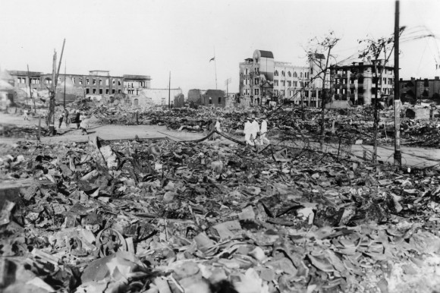
Why build sustainable structures?
To save property & lives and improve quality of urban living.
Though frequency of earth
quakes very high,
THE DEVELOPMENT CHALLENGE
The challenge is how can we quickly switch over to construction of sustainable structures, to mitigate damage to life & property. Thereafter , can pay attention to the retrofitting of the existing buildings, which are non- earthquake resistant.
Kanto, e/q, Japan; 1.9.1923
Deaths-1,42,800
Magnitude: 7.9
Only very few deaths after 1923 in Japan.
All structures constructed sustainable after this disaster incident.

Slide 5
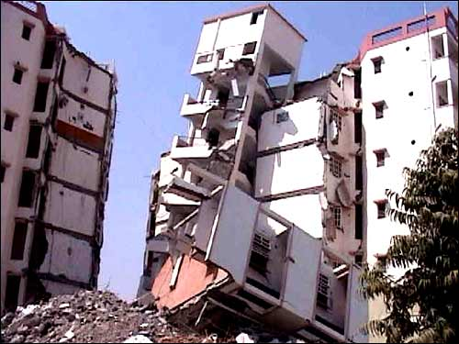
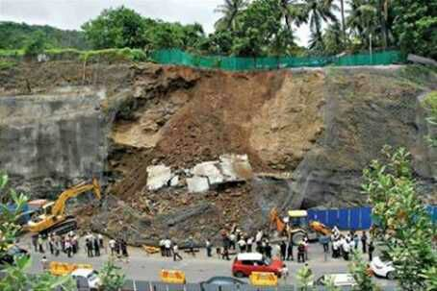
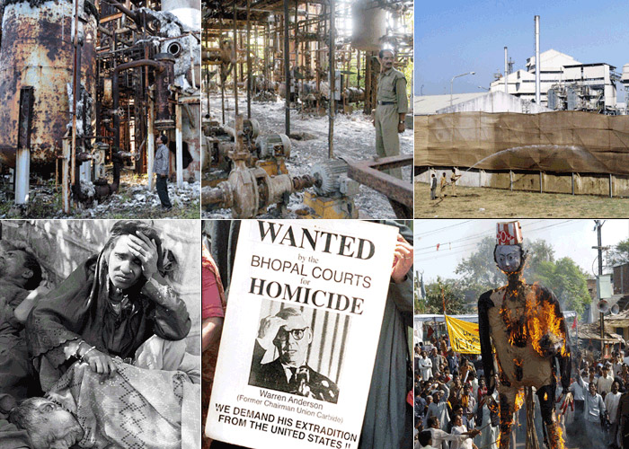
DISASTERS
During disasters Damage multiplies due to;
Non engineered structures (e.g. Bhuj buildings during e/q collapsed)
Creating imbalance or unsafe conditions in nature (e.g. landslide near Pune and in Uttarakhand)
Mending with existing safety norms (e.g. changing norms for construction within coastal regions or near river banks) e.g. Mumbai….CRZ 500m to 100m
Bhuj earthquake…due to non-engineered buildings
Landslide in Pune
Bhopal gas tragedy

Slide 6
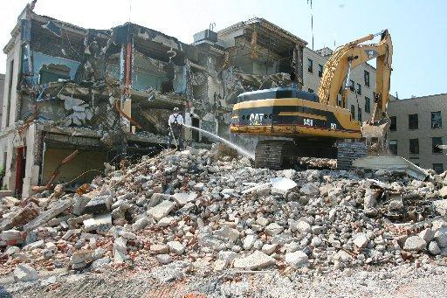
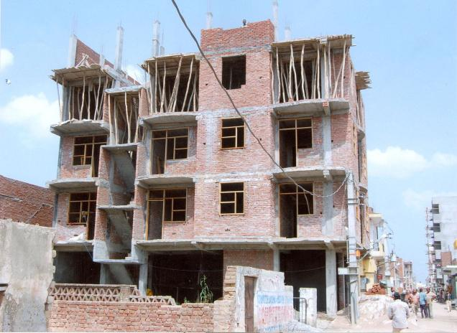
DISASTER RESILIENCE
Building disaster resilience is the term we use to describe the process of helping communities and countries to be better prepared to withstand and rapidly recover from a shock such as an earthquake, drought, flood or cyclone.
Non-Engineered Construction in Delhi even today
Resilience means the capacity of the system to withstand the adverse effects of natural hazards without collapsing.
Scale of Disaster Is Dependent on :
Non-engd. Bldgs,Lead time available, intensity of Hazard, Duration, Spatial extent, Density of Population , Assets and Time of Occurrence.

Slide 7
Earthquake
Earthquake Risk in India
India’s high earthquake risk and vulnerability is evident from the fact that about 59 per cent of India’s land area could face moderate to severe earthquakes. During the period 1990 to 2006, more than 23,000 lives were lost due to 6 major earthquakes in India, which also caused enormous damage to property and public infrastructure. The occurrence of several devastating earthquakes in areas hitherto considered safe from earthquakes indicates that the built environment in the country is extremely fragile and our ability to prepare ourselves and effectively respond to earthquakes is inadequate.
Gujarat earthquake of 2001
Sumatra India, Sri Lanka, Maldives 2004
Kashmir 2005
Gangtok, Sikkim 2011
All these major earthquakes established that the casualties were caused primarily due to the collapse of buildings. However, similar high intensity earthquakes in the United States, Japan, etc., do not lead to such enormous loss of lives, as the structures in these countries are built with structural mitigation measures and earthquake-resistant features. This emphasises the need for strict compliance of local bye-laws and earthquake-resistant building codes in India.

Slide 8
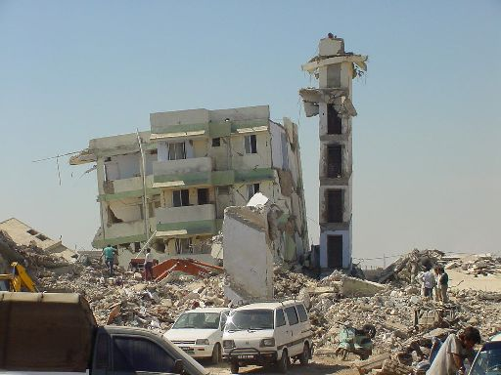
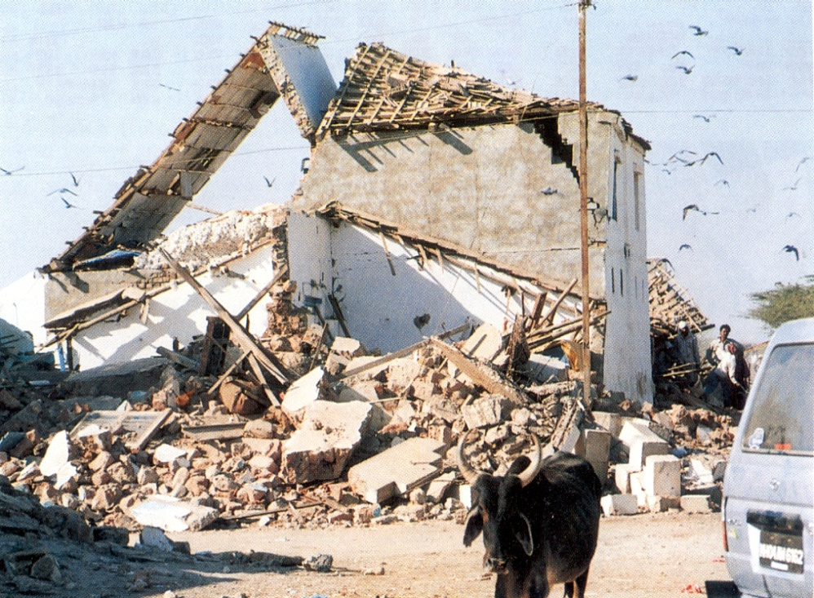
EARTHQUAKES
Gujurat earthquake In 2001 Bhuj, Ahmedabad deaths- 20,005 total no. affected- 6,321,812 total damage- 2.6 billion
Past earthquakes show that over 95 per cent of the lives lost were due to the collapse of buildings that were not earthquake-resistant.

Slide 9
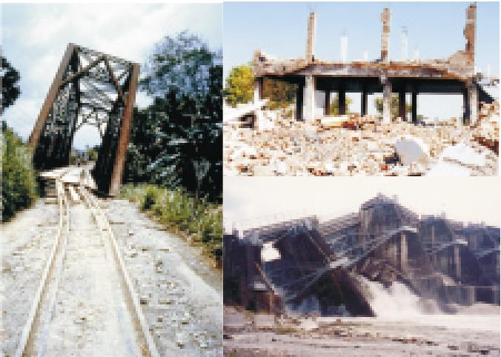
Earthquake
Damage to human settlement, buildings, structures and infrastructure, e.g. bridges, elevated roads, railways, water towers, pipelines, electrical generating facilities will continue if structure safety / sustainability is not ensured.
Aftershocks of an earthquake can cause much greater damage to already weakened structures.
Earthquakes also trigger other disasters like landslides, fire and floods etc.

Slide 10
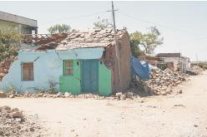
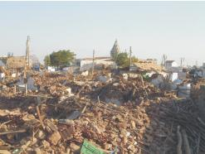
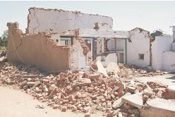
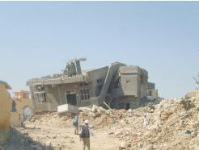
collapsed load bearing masonry buildings

Slide 11
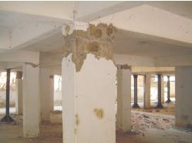
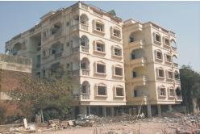
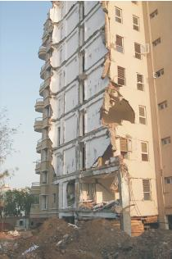
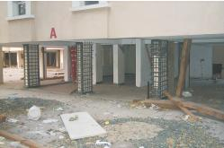
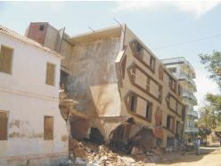
Damaged reinforced concrete frame buildings in Ahmedabad with open first storey and brick masonry infills.
One wing of the Shikhara building detached itself from the building and collapsed & repaired
The columns on one edge collapsed

Slide 12
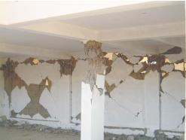
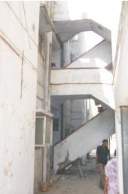
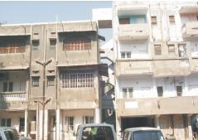
POUNDING AND OTHER FAILURES DURING EARTHQUAKES
The hinge regions of the columns in the open first storey of this building in Anjar are heavily damaged; complete collapse of the building was prevented by the presence of a few infill walls, which although heavily damaged remained in their place.
Two adjoining buildings in Maninagar; the interconnect-ing staircase allowed the building on the left to support the building on the right.

Slide 13
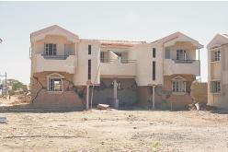
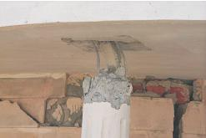
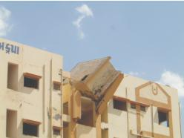
SOME FAILURES DURING EARTHQUAKES
Row of semi-detached houses in Samkhiali; note the open spaces in the first storey, the masonry infill wall at the back, and the slender columns supporting the front of the build-ing.
A water tank supported by four short columns project-ing above the roof collapsed during the earthquake.

Slide 14
BUILDINGS FAILURE DURING THE 2001 BHUJ EARTHQUAKE DUE TO NON-PROVISIONS OF EARTHQUAKE RESISTANT
building structures were (i) load bearing masonry and (ii) reinforced concrete frames with unreinforced masonry infill walls.
The types of masonry units used include (i) random rubble stones, (ii) rough dressed stones, (iii) clay bricks, and (iv) solid or hollow con-crete blocks in mud mortar, lime mortar, or cement mortar. Roof structure -Manglore clay tiles laid on timber planks supported by purlins and rafters made from wooden logs or a reinforced concrete slab.
For more than one storey, RCC slab / roof.
For more than three storeys- RCC frames with unreinforced masonry infill.
an open storey at the ground, for parking as / bye-laws.
In a majority of buildings, up to 10 and 12 storeys high, the RCC columns are supported on isolated spread footings. The footings are located at some depth below the ground level to go past the fill material on the top. In general, no geotechnical investi-gation is carried out, and the quality of foundation soil is judged on the basis of visual inspection. Foundation ties are not provided.
Performance of load bearing masonry buildings
No reinforcement had been provided in any of the buildings masonary walls. The walls were not tied to each other or to the floors and roofs.
Most buildings used large-size, heavy stone blocks.
The roof construction of wooden logs and Manglore tiles was very heavy.
All of these factors made the buildings very vulnerable to damage during earthquake, leading to widespread destruction.
As would be expected, the worst performance was that of random rubble construction in mud mortar.

Slide 15
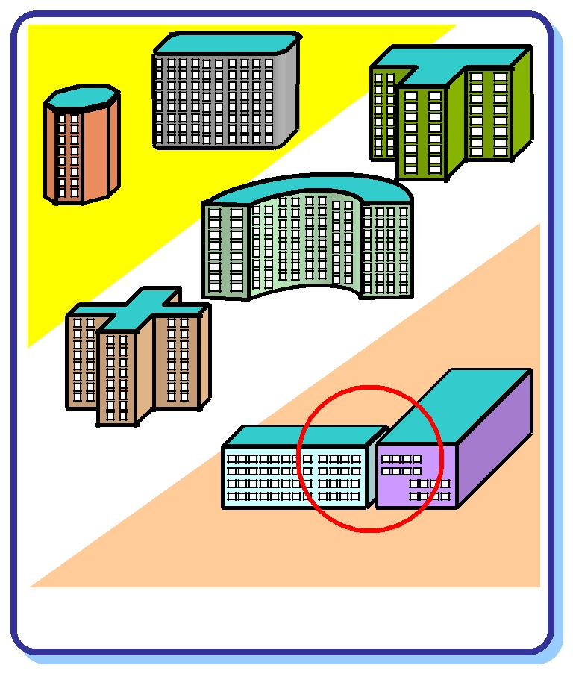
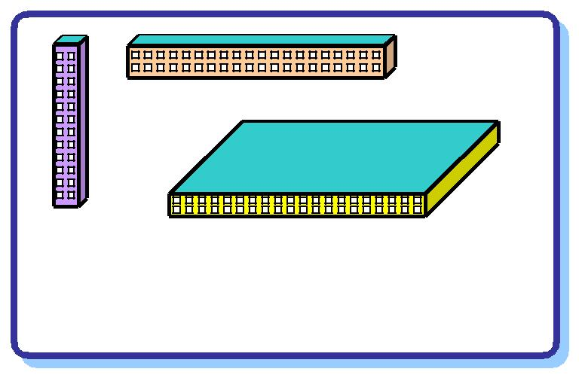
Architectural Features of earthquake- safety
The behaviour of a building during earthquakes depends critically on its overall shape, size and geometry, in addition to how the earthquake forces are carried to the ground
“If we have a poor configuration to start with, all the engineer can do is to provide a band-aid - improve a basically poor solution as best as he can. Conversely, if we start-off with a good configuration and reasonable framing system, even a poor engineer cannot harm its ultimate performance too much.”
Simple Plan
::good
Buildings with one of their overall sizes much larger or much smaller than the other two, do not perform well during earthquakes.
Separation joints make complex plans into simple plans
Corners and Curves :: poor
Simple plan shape buildings do well during earthquakes.

Slide 16
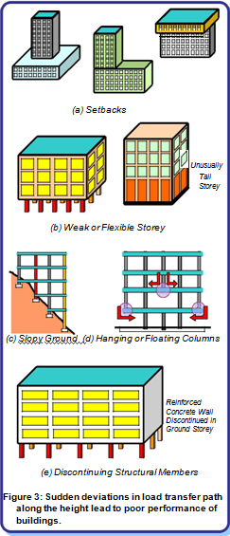
ARCHITECTURAL FEATURES of earthquake- safety

Slide 17
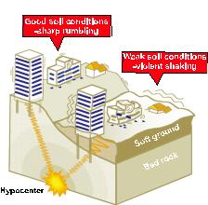
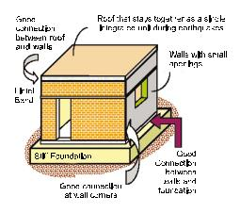
EARTHQUAKE-RESISTANT DESIGN
Essential requirements in a Masonry building
Effect of Soil type on ground shaking
PLINTH BAND
LINTEL BAND
ROOF SLAB/ROOF BAND
CORNER REINFORCEMENT AND REINFORCEMENT AROUND OPENINGS
BRICK WORK IN CEMENT MORTAR OF 1:6
RESTRICTED OPENINGS
PROPER FOUNDATIONS

Slide 18
BASIC PRINCIPLES FOR EARTHQUAKE RESISTANT DESIGN
ARCHITECT AND ENGINEER (DESIGNER) TO COLLABORATE FOR BASIC CONFIGURATION
FOLLOW THE SEISMIC DESIGN CODES AND GUIDELINES
AVOID SOFT STOREY ON GROUND FLOOR ELSE DESIGN AS PER CODES
AVOID SOFT STOREY ON UPPER FLOORS
AVOID ASYMMETRIC CONFIGURATIONS AND BRACINGS
AVOID DISCONTINUITIES IN STIFFNESS
AVOID TOO SLENDER WALLS
AVOID MIXING OF TWO SYSTEMS LIKE RCC AND LOAD BEARING CONSTRUCTION
SEPARATE NON STRUCTURAL MEMBERS WITH STRUCTURAL MEMBERS BY JOINTS

Slide 19
CONTD.
PROVIDE PLINTH BANDS/LINTEL BANDS/ROOF BANDS, CORNER REINFORCEMENT AND REINFORCEMENT AROUND OPEINING IN LOAD BEARING STRUCTURES.
AVOID PARTIALLY INFILLED FRAMES
SEPARATE ADJACENT BUILDINGS OR DIFFERENT STORIED BLOCKS BY JOINTS TO AVOID POUNDING
USE COMPACT PLAN CONFIGURATION
PROVIDE DUCTILE STRUCTURE
PROVIDE REQUIRED HOOKS IN TRANSVERSE REINFORCEMENT IN COLUMNS
NO OPENINGS OR RECESSES IN PLASTIC ZONES (IN RCC MEMBERS)
SECURE CONNECTIONS IN PRE FAB BUILDINGS
ASSESS THE LIQUEFACTION POTENTIAL FAILURE OF FOUNDATION
ANCHOR FACADE ELEMENTS FOR HORIZONTAL FORCES
ANCHOR FREE STANDING PARAPETS AND WALLS
FASTEN SUSPENDED CEILINGS AND LIGHT FITTINGS
FASTEN INSTALLATIONS AND EQUIPMENT

Slide 20
Retrofitting
Essential due to structures not built as per codes
Guidelines available from BIS for RCC as well as for load bearing construction (IS 13935)
There are approximately 12 crore buildings in seismic Zones III, IV and V. Most of these buildings are not earthquake-resistant and are potentially vulnerable to collapse in the event of a high intensity earthquake. As it is not practically feasible or financially viable to retrofit all the existing buildings, these Guidelines recommend the structural safety audit and retrofitting of select critical lifeline structures and high priority buildings. Such selection will be based on considerations such as the degree of risk, the potential loss of life and the estimated financial implications for each structure, especially in high-risk areas, i.e., in seismic Zones III, IV and V.
Seismic retrofitting is required not only for the structures of buildings (including their foundations) but also for their non-structural components like building finishes and contents. Seismic retrofitting is a specialised technical task which needs to be handled by engineers proficient in this field, as any routine alteration, repair or maintenance carried out in a structure may not always guarantee an improvement in its seismic safety, and may in fact, increase its vulnerability.

Slide 21
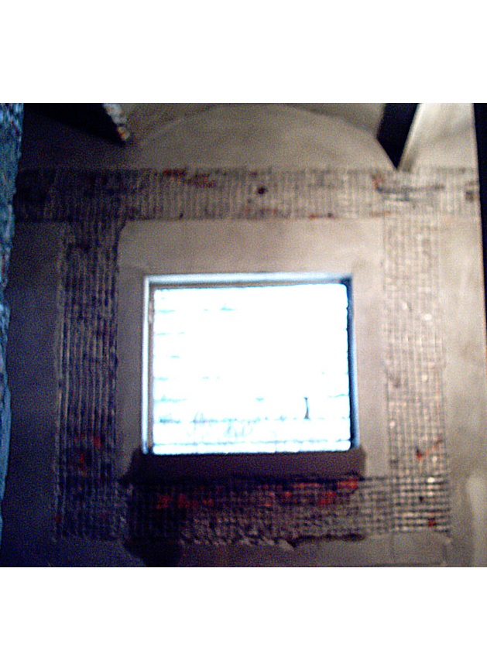
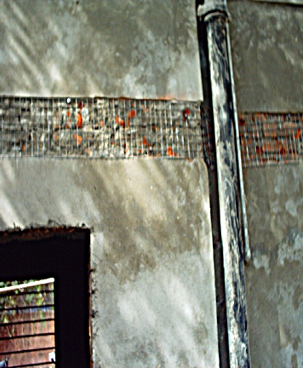
ON ALL WALLS
ON BOTH THE FACES
ABOVE LINTEL

Slide 22
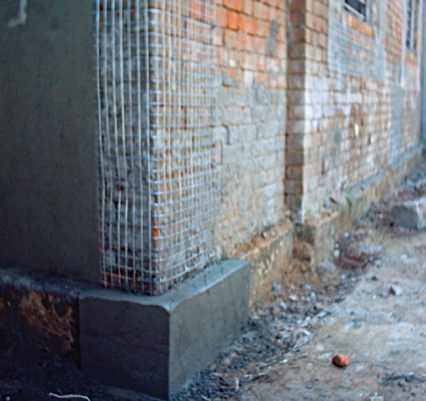
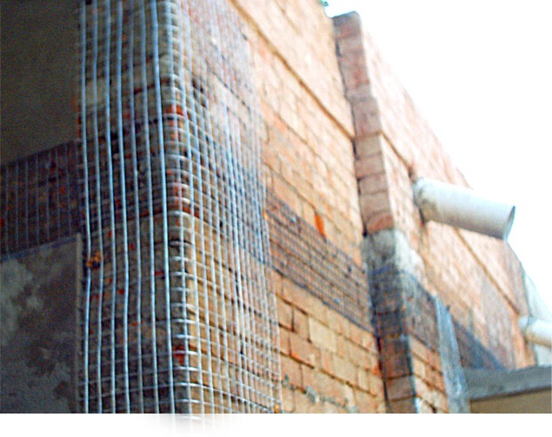

Slide 23
SIX PILLARS OF EARTHQUAKE MANAGEMENT.
Ensure the incorporation of earthquake-resistant design features for the construction of new structures.
Facilitate selective strengthening and seismic retrofitting of existing priority and lifeline structures in earthquake-prone areas.
Improve the compliance regime through appropriate regulation and enforcement.
Improve the awareness and preparedness of all stakeholders.
End extreme urban poverty, expand employment and productivity, and raise living standards, especially in slums.
Strengthen the emergency response capability in earthquake-prone areas.
Codes developed also to be updated and made consistent with the current state-of-the-art techniques on earthquake-resistant design and construction.

Slide 24
Disaster Risk Reduction
1 . Preparedness includes planning and construction of sustainable structures during disasters.
To bring awareness by preparing and distributing pamphlets & making part of school & college education about what to do in case of disasters like earthquake & how to organise yourself.
Rural areas :- To bring awareness by distributing pamphlets / booklets indicating guidelines for construction of small safe buildings alongwith organising trainings at the levels of Panchayat, to Engineers, Administrators & workers.
Urban areas & Metros :- Along with above, all buildings must be designed by qualified professionals.
It should be mandatory to obtain certificate of structural safety before issue of approval by local body.
Data of inventories and response force must be available with the administration to take action in time during response and mitigation.
2. Mitigation
Once the steps of preparedness are followed and implemented in true spirit, the effects of disaster automatically gets minimised & mitigated.
Mitigation will require trained and well equipped disaster response forces at National, State and District levels
The next step is to start retrofitting of the existing structures.

Slide 25
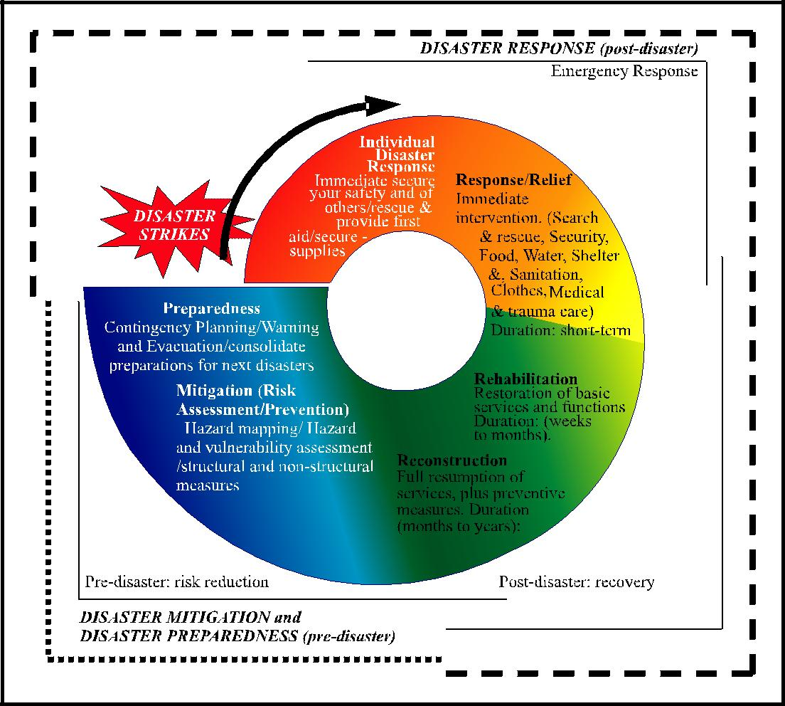

Slide 26
THANK YOU

