Slide 1

A MANUAL FOR MUNICIPAL DISASTER MANAGEMENT PLANS
Meghna Malhotra, Urban Management Centre
Workshop on
Sustainable and Disaster Resilient Urban Development

Slide 2
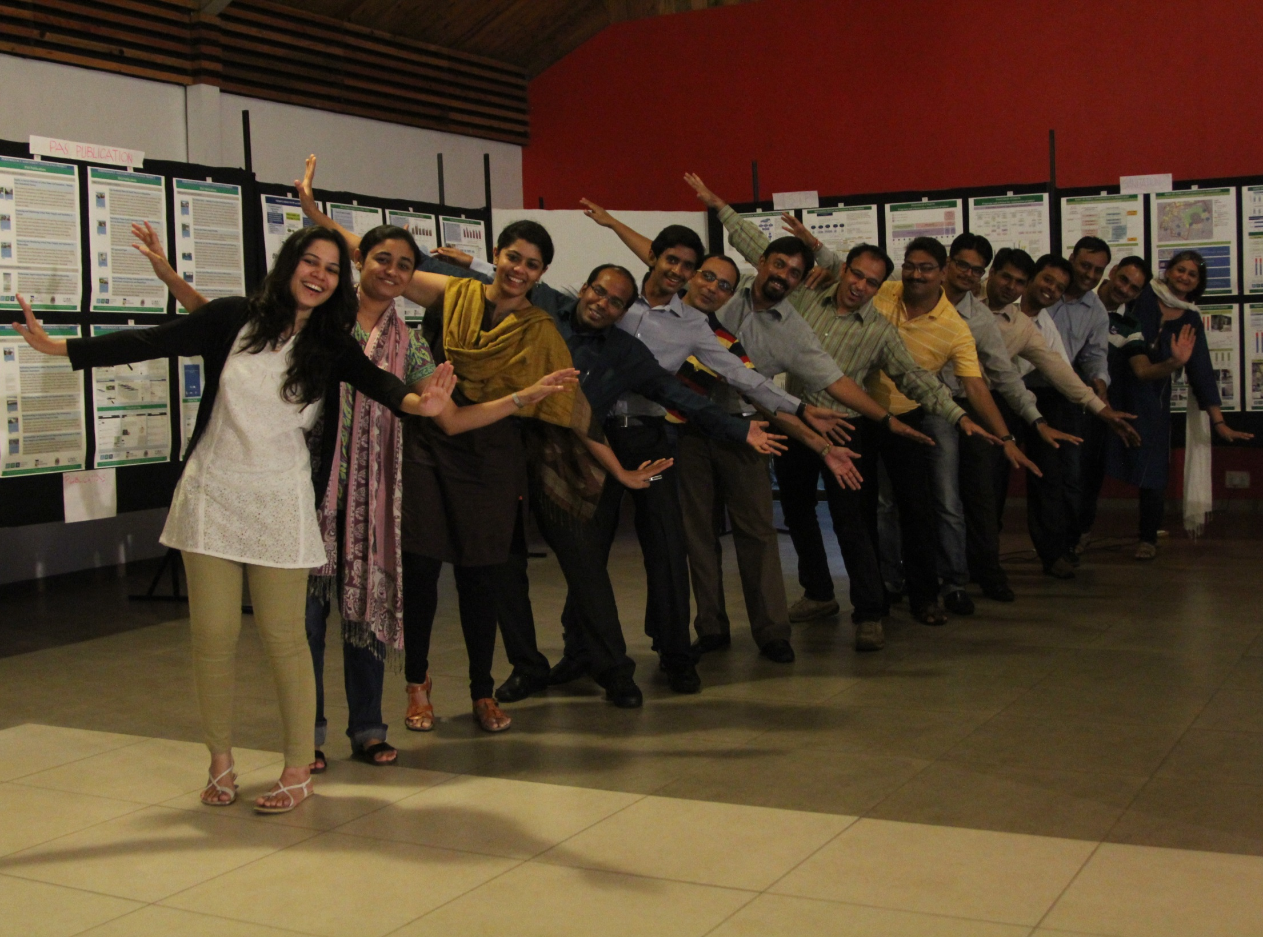
Started as ICMA’s Project Office in India and South Asia since 1997
Formally registered as a Not for Profit Section 25 Company “ Urban Management Centre” in 2005.
Lean organisation with 26 urban planners, architects, urban finance experts

Slide 3
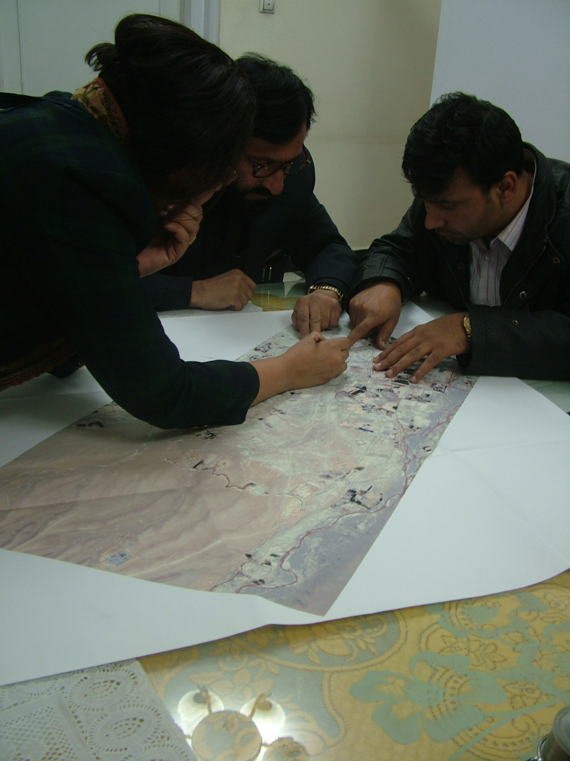
Have provided urban advisory services to local governments in
India,
Afghanistan,
Sri Lanka,
Indonesia
Ethiopia
Thailand
Nepal

Slide 4

Who are we?
We are a women promoted
not-for-profit organisation known as
friends of cities
We bridge gaps between urban local governments and
latest technology
Latest trends and innovations
Policy directives and guidelines
Information and knowledge
Resource organizations and solution providers
Academia
NGOs/CSOs

Slide 5
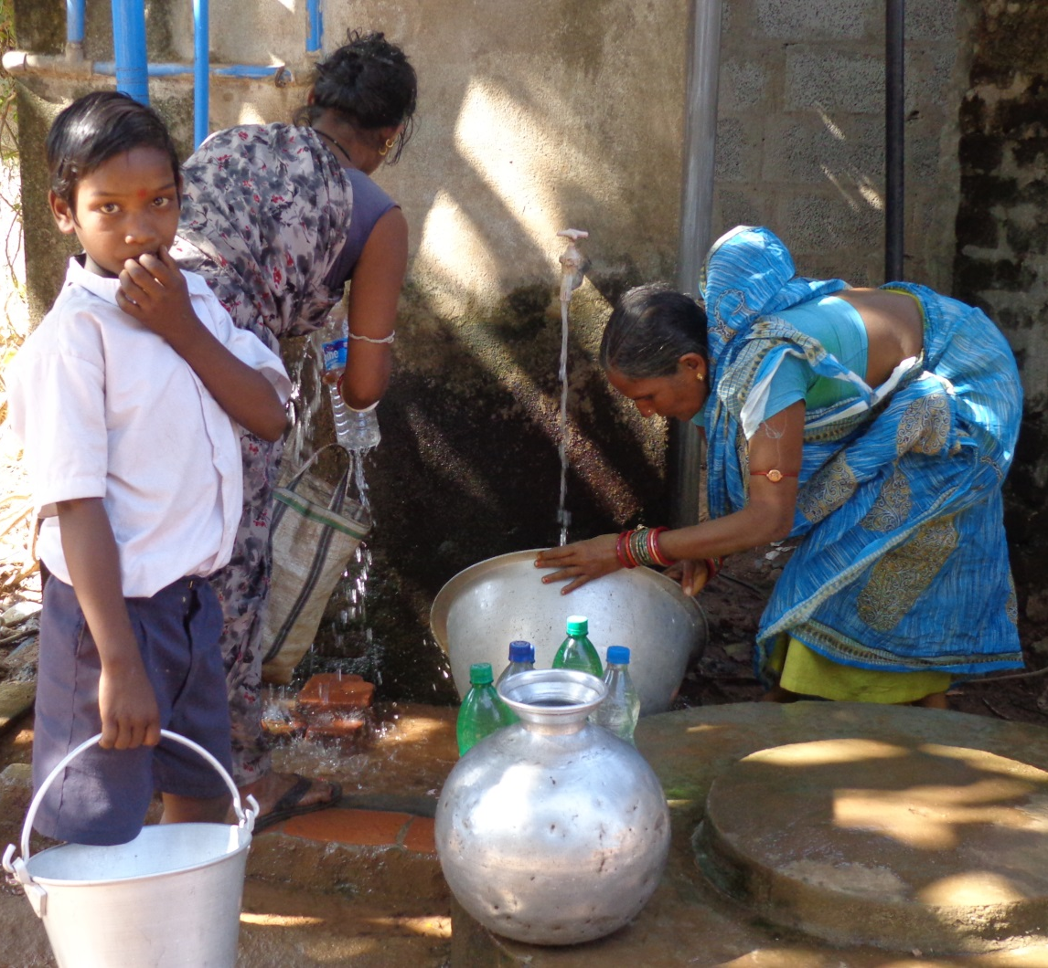
Our theory of Change?
Our theory of change is that if policy reforms are implemented; systems are strengthened; city managers are capacitated and empowered then cities would become cleaner, livable, productive and equitable.

Slide 6
What we do?
Build Associations of local governments: create platforms for co-learning and sharing local government practices
Advocacy: represent local government concerns in the public policy arena
Research and Documentation: policy and action research
Training and Capacity Building:
through focussed trainings, workshops, national and international study tours and programs, hand-holding support and dissemination of best practices
Survey and Technical Audits: of urban infrastructure, facilities and buildings using mobile technology. Have developed frameworks for listing and grading of heritage properties and other public assets
Data Visualization and Mapping
Of urban data for better understanding and improved decision making.

Slide 7
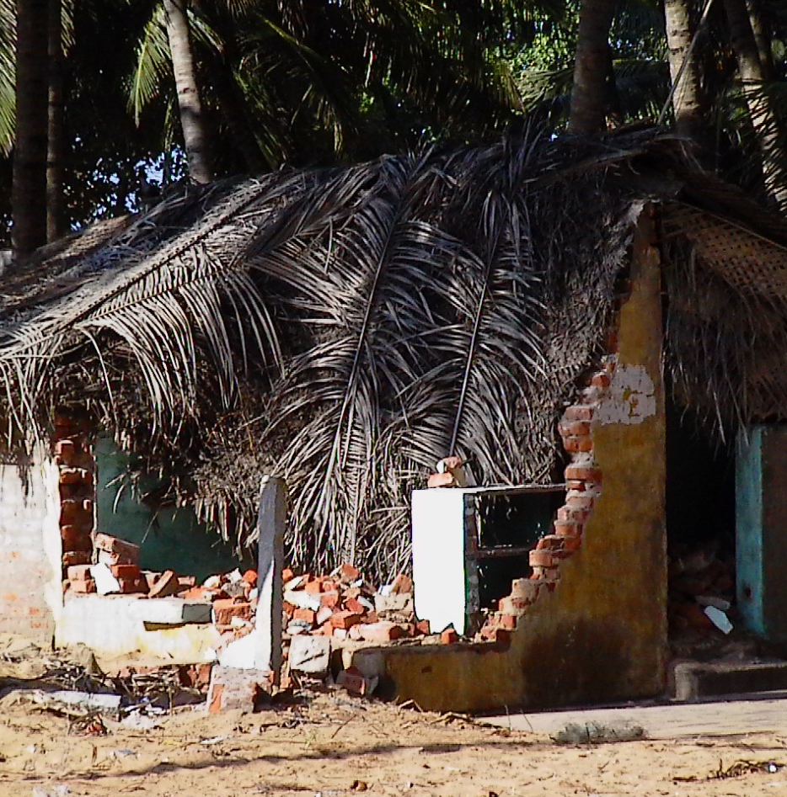
Manual for Preparing Disaster Management Plans
To help ULBs to prepare customize management plans to handle flood, cyclone, earthquake and fire hazards, as per their vulnerability.
Objective : to build resilient cities by initiating capacity building of their staff and identifying physical resources and linkages in the cities.
DMP would include preparedness planning , implementation of response and recovery activities.

Slide 8
Why each city Should Have a Disaster Management Plan
In times of disasters, people expect elected leaders and city officials to take immediate action to deal with the problem.
ULB is expected to marshal its resources, obtain and channelise the efforts of voluntary organisations and private sector organisations in the city, and solicit assistance from outside of the jurisdiction if necessary.

Slide 9
Manual aims to help ULBs in
Identifying their city’s vulnerability to cyclone, flooding, earthquake, fire hazards and will be able to identify the most vulnerable populations within their jurisdictions.
Preparedness planning to face cyclone, flooding, earthquake, fire hazards.
preparation of resource requirements-both in terms of human and material, identification of sources for mobilization
charting out roles and responsibilities of their staffs to be able to manage incidence of a hazard- cyclone, flooding, earthquake, fire.

Slide 10
Methodology of preparing the manual
Reviewed State and ULB processes
Reviewed existing guidelines by
  GSDMA etc
  National Emergency Management Network of ICMA, US
  Cities of Florida, US and reviewed their plans
Validated draft manual with cities of Andhra Pradesh

Slide 11
Manual Design
Section A- gives an overview of DM and also highlights the role of various organizations including ULBs in DM.
Section B- provides step by step methodology to prepare the DMP by an ULB. It provides recommendations on each aspect of the DMP
Section C- contains the templates where urban local bodies can enter their specific data and information to prepare the DMP.

Slide 12
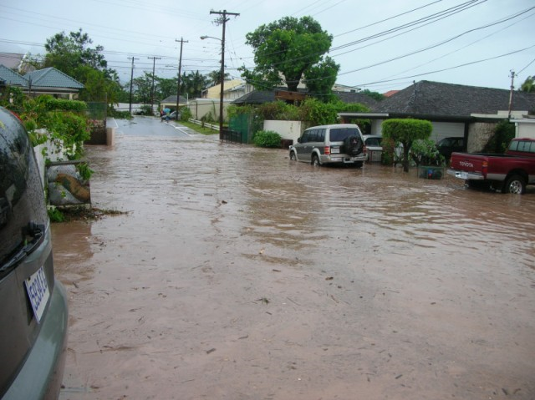
  SECTION A Introduction to Disaster Management Environment and Disaster Management Plans
Introduces the disaster management landscape at national, state levels.
What is a Disaster Management Plan
What it is not?
  Mitigation plan
  Recovery plan
  Preparedness plan
Methodology for the ULB to prepare its DMP
Notes:
the DMP facilitates response and short-term recovery (which set the stage for successful long-term recovery)

Slide 13

Principles for Developing a Disaster Management Plan
Don't Reinvent the Wheel
Build on What Exists in the Jurisdiction-Existing plans can point applicable authorities, perceptions of risk in the community, members of the city’s emergency, response organization, coordination with other jurisdictions, and more.
Keep it a team approach-since emergency response is also a team approach, seek commitment of departments in preparatory phase as well.

Slide 14
Potential Team Members for the DMP preparation
A comprehensive indicative list:
Municipal Commissioner/ Chief Officer or equivalent
Fire/rescue, and emergency medical services, public health and safety, etc.
Existing planning agencies (e.g., urban community development, town planning dept).
Public works department
Engineering Department, any private utility companies.
Chief Financial Officer, auditor
Non-Government Organisations and volunteer organizations
Area hospitals, emergency medical service agencies,.
Education Department
Public Information Officer (PIO).
Local media.
Industrial and military installations in the area.
State aviation authority and/or others connected with provision of air support.
Port authorities
Organizations in the animal care and control community, including veterinary services.
Amateur radio groups,
Representatives from neighbouring jurisdictions, to coordinate mutual aid needs.
State and/or Govt. of India representatives, as appropriate.

Slide 15
Methodology that the ULB should adopt for preparing the DMP
Research-review the city’s planning framework.
Conduct Hazard and/Risk Vulnerability Analysis-profile hazards, their consequences, compare and prioritize risks
Determine the Resource Base of the city
Note special aspects of the Planning Environment-geographical features, any special groups in city,
Develop the DMP
Validation- check for conformity with state Act and Laws.
Plan Review
Plan Testing
Maintenance
Plan Distribution and Approval

Slide 16
  SECTION B Step by step process on putting together the Disaster Management Plans
Chapter 1- City/Town’s Preamble
Chapter 2- Profile of the City (Various Segments)
Chapter 3- Preparation of Disaster History Profile and Vulnerability Assessment (Templates)
  Base Information and Indicators ; excel based template
  Sorting of all parameters
  Ranks
  Final Vulnerability Result
  Mapping of the result of the analysis
  Overlay of Maps

Slide 17
  SECTION B Step by step process on putting together the Disaster Management Plans
Chapter 4- Institutional Structure
  Disaster Management Facilities
  Organization and staffing
  Roles and responsibilities
  Preparedness actions
  Operational actions
  Communications plans and protocols
  Coordination with other jurisdictions and levels of government
  Public information

Slide 18
Disaster Management Facilities
  Setting up of a Control Room
  Facilities at the control Room
  Setting Branch Control Room
  Transport
  Staffing at Control Rooms
Information Flow from Control Room (Flow Chart)
Organizing and Staffing
  - Prepare a Normal Staffing chart
  - Disaster Preparedness Team
  - Staffing Organization in Disaster Incidence (Organizational Structure)
  - Identify Leads and Supporting Roles across disaster management function

Slide 19
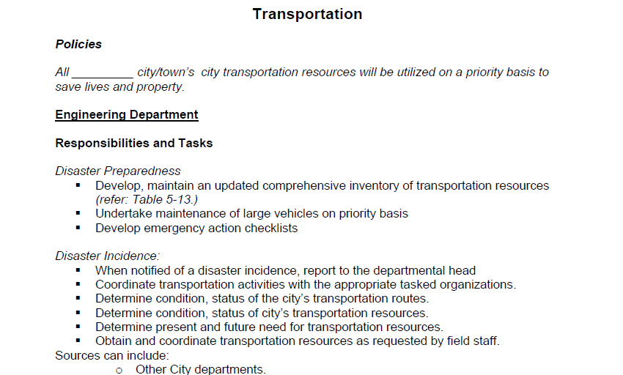

Slide 20
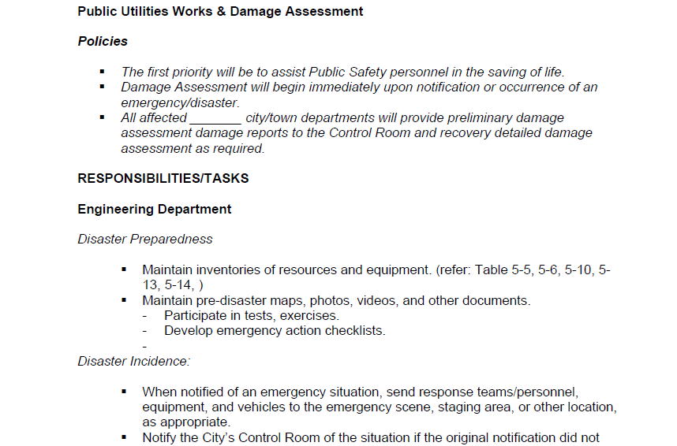

Slide 21
  Formation of Disaster Preparedness Team
  Coordination of Preparedness Activities with in the ULB
  Training on the ULB’s DMP and specific roles and responsibilities.
  Conduct annual Exercise and After Action Report
  Evaluation and Improvement Planning
  Public Education and Community Outreach
  Resource Classification

Slide 22
  Chapter 5: Disaster Preparedness planning
Identification of Temporary Shelters
  Estimation of needs of temporary Shelters based on Vulnerability
  List of available shelters
  Need for establishing temporary shelters
Planning of Evacuation Routes
Resources needed for Search and Rescue
  Materials required for search and rescue operations
  Specialized search and rescue materials for flood
  Skilled human resources required for search and rescue operations
Pre Monsoon Flood/Cyclone Contingency Planning for ULBs
  Role and responsibilities of various departments

Slide 23
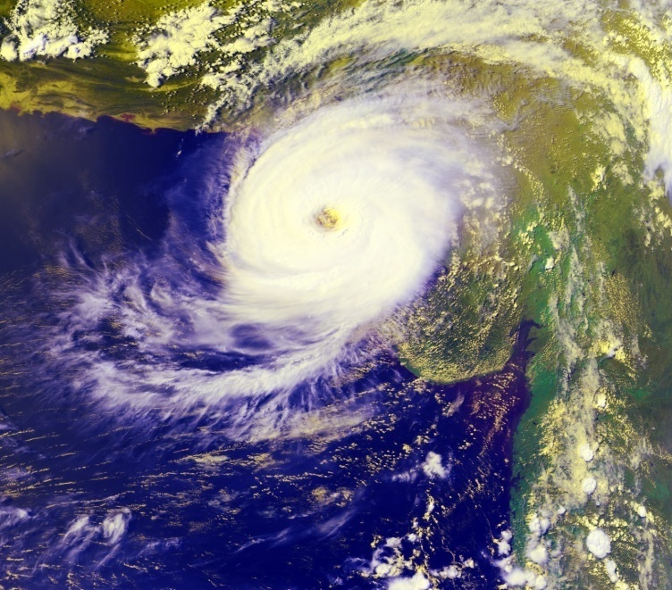
  Chapter 6: Emergency Operations Procedure
  Disaster Response activities at the onset of the disaster incident.
  Early warning and Communication for cyclones and flooding for disaster prone areas
  Personnel Notification
  Initial Actions
    Rapid situation assessment
    Evacuation
    Search and Rescue
    First aid and distribution of relief materials
    Shelter management

Slide 24
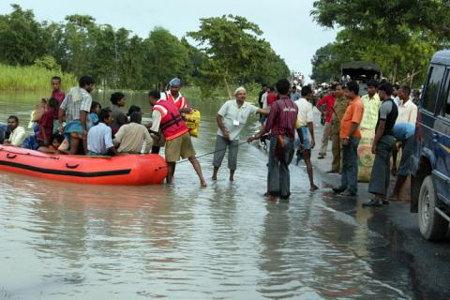
  Disaster Recovery
  Initial damage assessment
      The damage assessment is done separately for public and private properties
      Assistance for damage to public properties includes Debris clearance, Emergency Protective measures, road system, Water control facilities, Building and equipments, Public utilities system
      Assistance for damage to individual property includes Damage to residences, Damage to business, Debris clearance, Emergency Protective measures, road system, Water control facilities, Building and equipments, Public utilities system

Slide 25
    Compensation and relief packages
    Restoration of normalcy at the notified disaster site
  Daily action taken report
  Financial reporting template
  Deactivation of emergency facilities
    Defining the procedure and schedule for documentation of ULB’s response and short-term recovery operations
    Identifying the need for replacement, return, or repair of equipment and supplies utilized during the activation period and assign responsibility
    Indicate extent of long term recovery processes
    Summarize what worked and what did not; incorporate learnings into the DMP

Slide 26
  SECTION C Templets of the Disaster Management Plans

Slide 27
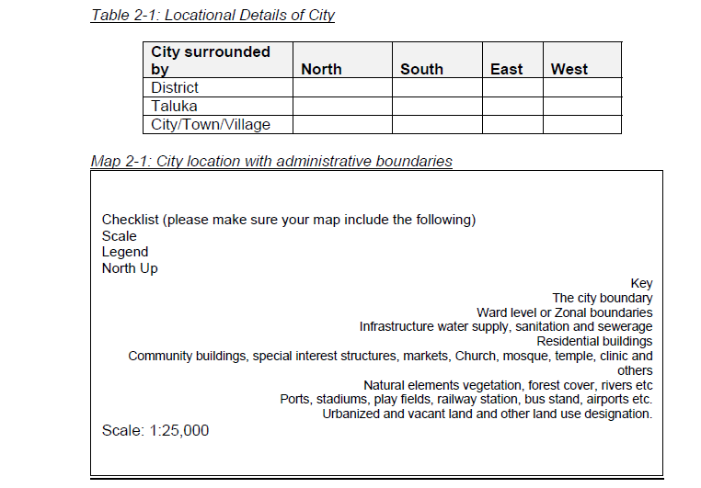

Slide 28
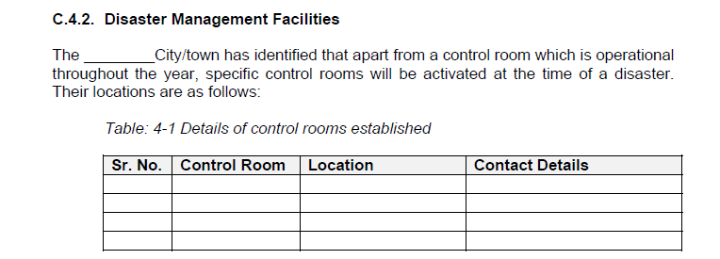
The manual can be accessed at:
http://www.umcasia.org/content.php?id=55

Slide 29
Thank You
Urban Management Centre
c/o 3rd Floor, AUDA, Usmanpura, Ashram Road
Ahmedabad
www.umcasia.org; info@umasia.org

